Slide 1
Lecture 26
Chemical Reaction Engineering (CRE) is the field that studies the rates and mechanisms of chemical reactions and the design of the reactors in which they take place.

Slide 2
Web Lecture 26 Class Lecture 22
Course Information
Materials on Ctools
Review of 342 Mass Transfer Without Reaction
Diffusion and Fick’s Law
Mass Transfer Coefficient
Drug Delivery Patches
Robert The Worrier

Slide 3
P14-2_{B}
Binary System
Multiply and divide by

Slide 4
1. For equal molar counter diffusion

Slide 5
2. Diffusion through a stagnant film,
3. For dilute concentration

Slide 6
2. Diffusion through a stagnant film, W_{B} = 0
3. For dilute concentration

Slide 7
2. Diffusion through a stagnant film, W_{B} = 0
3. For dilute concentration

Slide 8
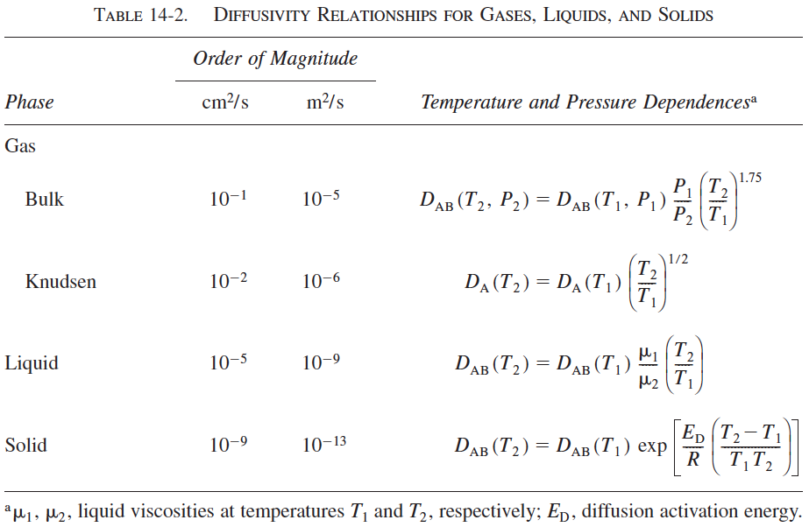
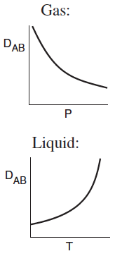

Slide 9
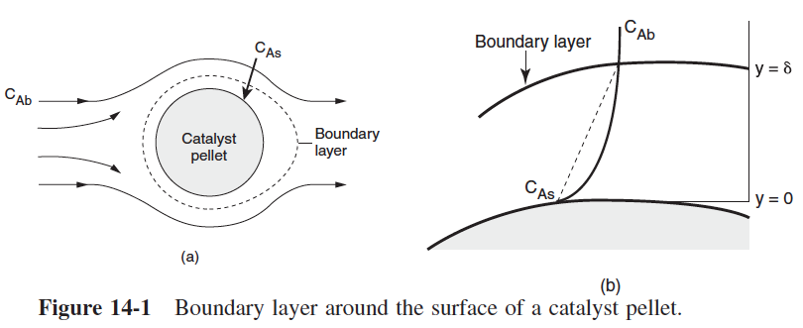
Mass Transfer Coefficient

Slide 11
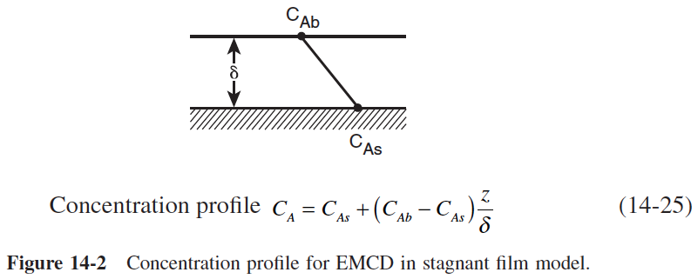

Slide 14
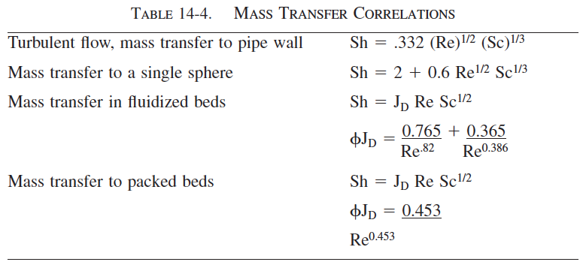

Slide 15
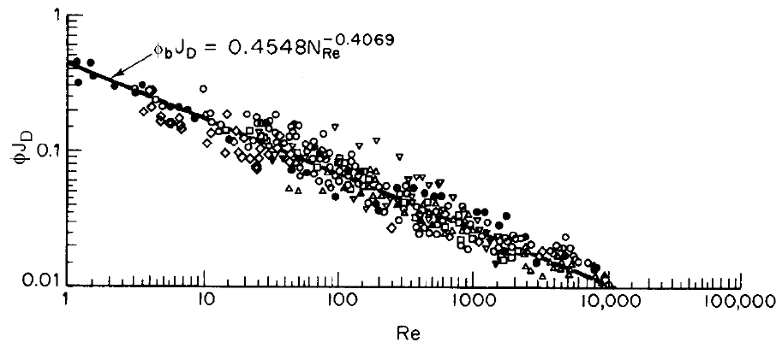
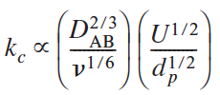

Slide 16
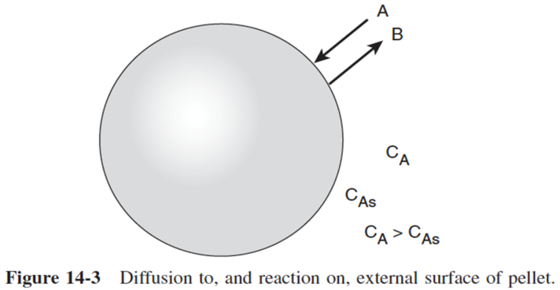
We need to eliminate C_{As}.

Slide 17
One will often find the flux to or from the surface as written in terms of an effective transport coefficient k_{eff}:
Case 1

Slide 18
One will often find the flux to or from the surface as written in terms of an effective transport coefficient k_{eff}:
where
Case 1
Case 2

Slide 19
One will often find the flux to or from the surface as written in terms of an effective transport coefficient k_{eff}:
where
Case 1
Case 2

Slide 20
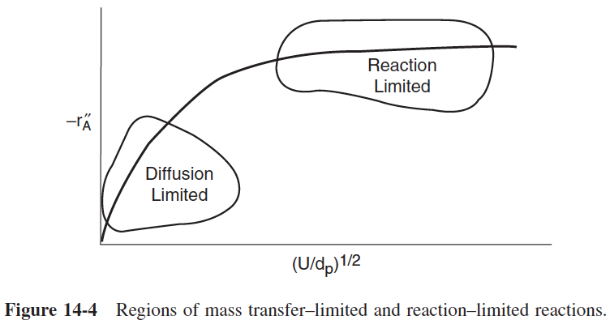

Slide 21
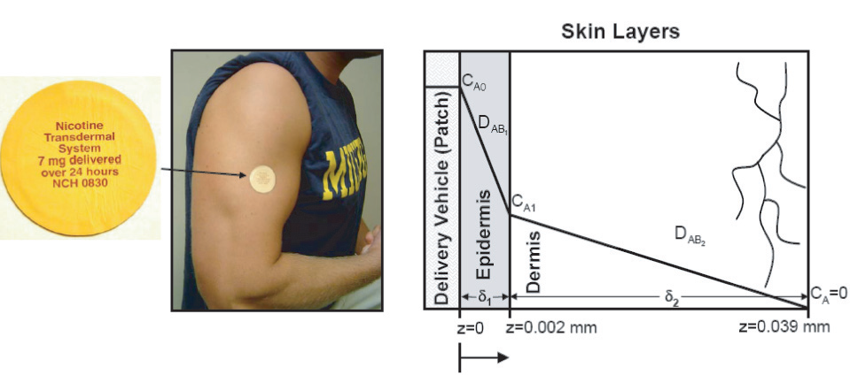
Transdermal drug delivery schematic.

Slide 22
Step 1. Diffusion of A through the Epidermis film, which is stagnant reduces to
Step 2. Use Fick’s law to relate the flux W_{Az} and the concentration gradient
Step 3. State the boundary conditions

Slide 23
Step 4. Next substitute for W_{Az} and divide by D_{A1} to obtain
Integrating twice

Slide 24
Step 4.
Using the boundary conditions we can eliminate the constants K₁ and K₂ to obtain the concentration profile
Step 5. Substituting CA we obtain the flux in the Epidermis layer

Slide 25
Step 6. Carry out a similar analysis for the Dermis layer starting with
We find
Substituting
Step 7. At the interface between the Epedermis and Dermis layer, i.e., at z = δ₁

Slide 26
Substituting
Step 7. At the interface between the Epedermis and Dermis layer, i.e., at z = δ₁
Equating Equations (E14-1.5) and (E14-1.6)

Slide 27
Step 7. At the interface between the Epedermis and Dermis layer, i.e., at z = δ₁
Equating Equations (E14-1.5) and (E14-1.6)
Solving for C_{A1}

Slide 28
Step 7. At the interface between the Epedermis and Dermis layer, i.e., at z = δ₁
Substituting for C_{A1} in Equation (E14-1.10)

Slide 29
If we consider there is a resistance to the drug release in the patch, R_{P}, then the total resistance is
If the resistance in the dermis layer is neglected

Slide 30
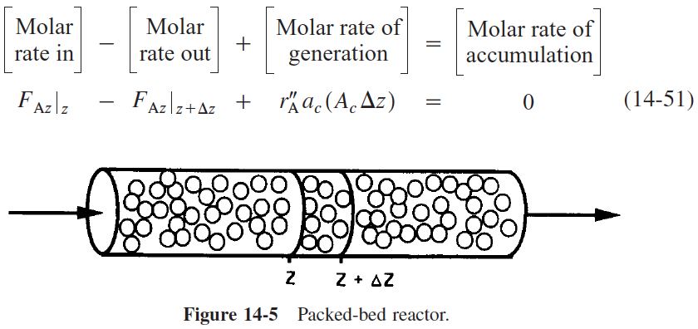

Slide 31
Neglect

Slide 33
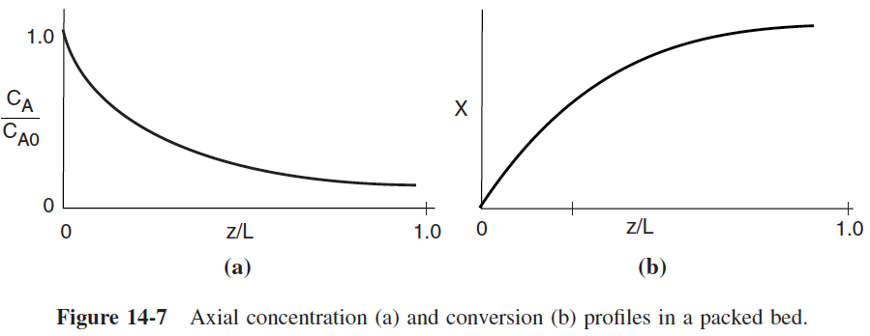

Slide 34
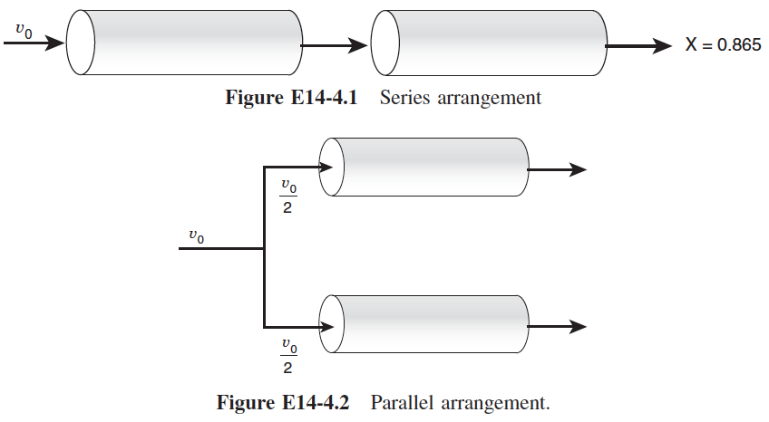
Robert the Worrier

Slide 41
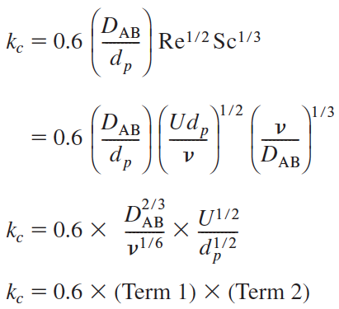
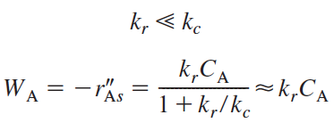
One will often find the flux to or from the surface as written in terms of an effective transport coefficient k_{eff}:
where

Slide 43
Step 4. Next substitute for W_{Az} and divide by D_{A1} to obtain
Integrating twice
using the boundary conditions we can eliminate the constants K₁ and K₂ to obtain the concentration profile
Step 5. Substituting CA we obtain the flux in the Epidermis layer

Slide 44
