Slide 1
Lecture 8
Chemical Reaction Engineering (CRE) is the field that studies the rates and mechanisms of chemical reactions and the design of the reactors in which they take place.

Slide 2
Lecture 8 – Tuesday 2/5/2013
Block 1: Mole Balances
Block 2: Rate Laws
Block 3: Stoichiometry
Block 4: Combine
Pressure Drop
Liquid Phase Reactions
Gas Phase Reactions
Engineering Analysis of Pressure Drop

Slide 3
Pressure Drop in PBRs
Concentration Flow System:
Gas Phase Flow System:

Slide 4
Pressure Drop in PBRs
Note: Pressure Drop does NOT affect liquid phase reactions
Sample Question:
Analyze the following second order gas phase reaction that occurs isothermally in a PBR:
A→B
Mole Balances
Must use the differential form of the mole balance to separate variables:
Rate Laws
Second order in A and irreversible:

Slide 5
Pressure Drop in PBRs
Stoichiometry
Isothermal, T=T₀
Combine:
Need to find (P/P₀) as a function of W (or V if you have a PFR)

Slide 6
Pressure Drop in PBRs
Ergun Equation:
Constant mass flow:

Slide 7
Pressure Drop in PBRs
Variable Density
Let

Slide 8
Pressure Drop in PBRs
Catalyst Weight
Where
Let

Slide 9
Pressure Drop in PBRs
We will use this form for single reactions:
Isothermal case

Slide 10
Pressure Drop in PBRs
and
or
The two expressions are coupled ordinary differential equations. We can only solve them simultaneously using an ODE solver such as Polymath. For the special case of isothermal operation and epsilon = 0, we can obtain an analytical solution.
Polymath will combine the Mole Balances, Rate Laws and Stoichiometry.

Slide 11
Packed Bed Reactors

Slide 12
1
Pressure Drop in a PBR
P
W

Slide 13
2
Concentration Profile in a PBR
C_{A}
W

Slide 14
3
Reaction Rate in a PBR
-r_{A}
W

Slide 15
4
Conversion in a PBR
X
W

Slide 16
5
Flow Rate in a PBR
1
W

Slide 18
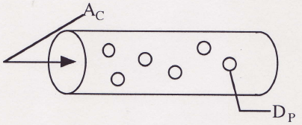
Example 1: Gas Phase Reaction in PBR for δ=0
Gas Phase reaction in PBR with δ = 0 (Analytical Solution)
A + B → 2C
Repeat the previous one with equimolar feed of A and B and:
k_{A} = 1.5dm⁶/mol/kg/min
α = 0.0099 kg⁻¹
Find X at 100 kg

Slide 19
Example 1: Gas Phase Reaction in PBR for δ=0
1) Mole Balance
2) Rate Law
3) Stoichiometry

Slide 20
Example 1: Gas Phase Reaction in PBR for δ=0
,
,
4) Combine

Slide 21
Example 1: Gas Phase Reaction in PBR for δ=0

Slide 22
Example 2: Gas Phase Reaction in PBR for δ≠0
The reaction
A + 2B → C
is carried out in a packed bed reactor in which there is pressure drop. The feed is stoichiometric in A and B.
Plot the conversion and pressure ratio y = P/P₀ as a function of catalyst weight up to 100 kg.
Additional Information
k_{A} = 6 dm⁹/mol²/kg/min
α = 0.02 kg⁻¹

Slide 23
Example 2: Gas Phase Reaction in PBR for δ≠0
A + 2B → C
1) Mole Balance
2) Rate Law
3) Stoichiometry: Gas, Isothermal

Slide 24
Example 2: Gas Phase Reaction in PBR for δ≠0
4)
5)
6)
7)
Initial values: W=0, X=0, y=1 Final values: W=100
Combine with Polymath.
If δ≠0, polymath must be used to solve.

Slide 25
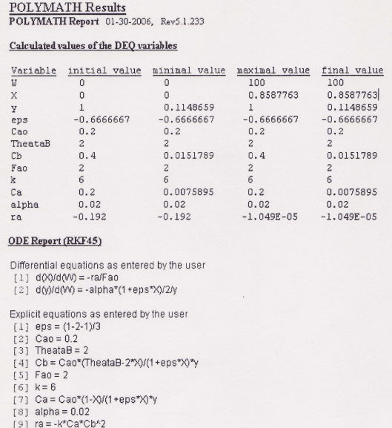
Example 2: Gas Phase Reaction in PBR for δ≠0

Slide 26
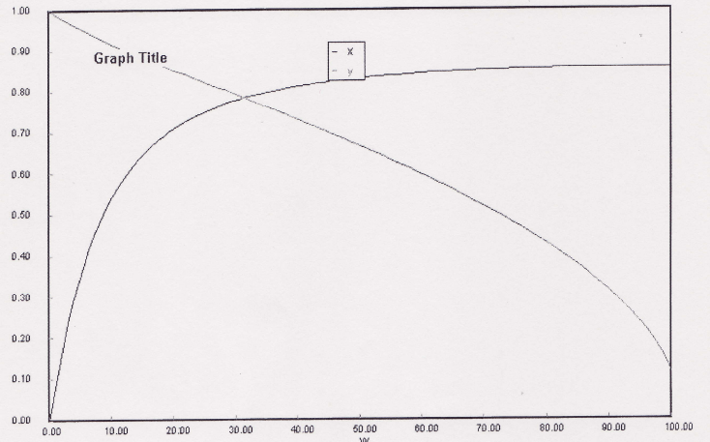
Example 2: Gas Phase Reaction in PBR for δ≠0

Slide 27
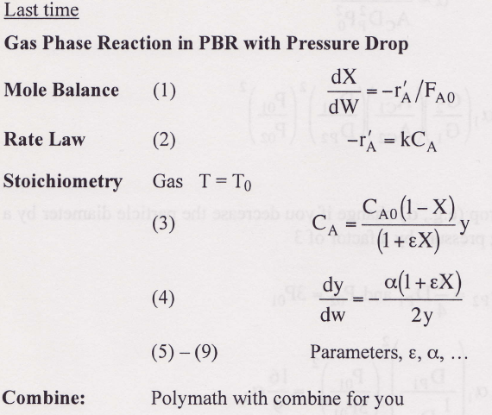
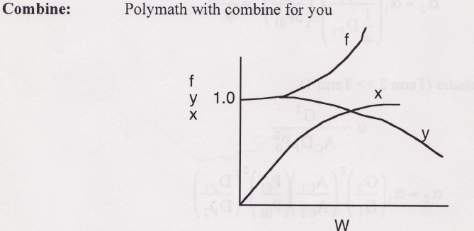
T = T₀

Slide 28
Robert the Worrier wonders: What if we increase the catalyst size by a factor of 2?

Slide 29
Pressure Drop Engineering Analysis
$$ρ_{0}=MW∗C_{T0}=\frac{MW∗{ P}_{0}}{RT_{0}}$$
$$α=\frac{2RT_{0}}{A_{C}ρ_{C}g_{C}P_{0}^{2}D_{P}φ^{3}MW}G\left[\frac{150\left(1−φ\right)μ}{D_{P}}+1.75G\right]$$
$$α≈{\left(\frac{1}{P_{0}}\right)}^{2}$$

Slide 30
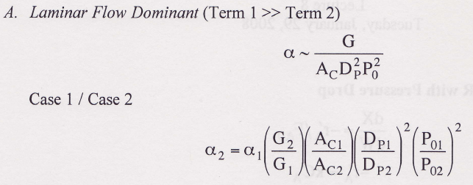
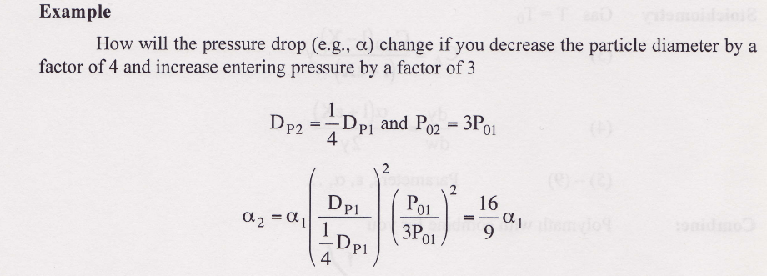
Pressure Drop Engineering Analysis

Slide 31
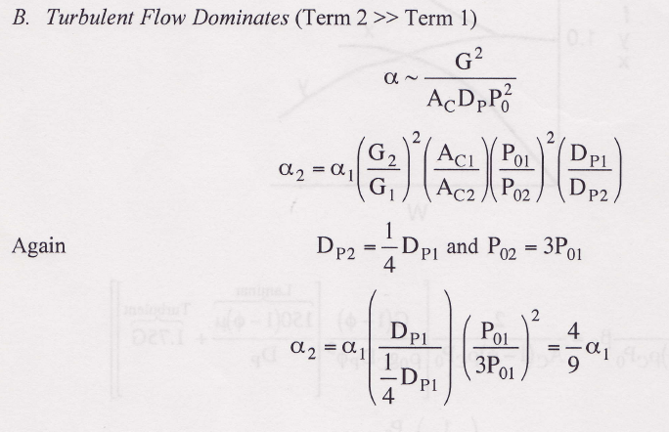
Pressure Drop Engineering Analysis

Slide 32
Heat Effects
Isothermal Design
Stoichiometry
Rate Laws
Mole Balance

Slide 33
End of Lecture 8

Slide 34
Pressure Drop - Summary
Pressure Drop
Liquid Phase Reactions
Pressure Drop does not affect concentrations in lquid phase reactions.
Gas Phase Reactions
Epsilon does not equal to zero
d(P)/d(W)=…
Polymath will combine with d(X)/d(W) =… for you
Epsilon = 0 and isothermal
P=f(W)
Combine then separate variables (X,W) and integrate
Engineering Analysis of Pressure Drop

Slide 35
Pressure Change – Molar Flow Rate
Use for heat effects, multiple rxns
Isothermal: T = T₀

Slide 36
Example 1: Gas Phase Reaction in PBR for δ=0
A + B → 2C
Case 1:
Case 2:

Slide 37
PBR

