Slide 1
Lecture 15
Chemical Reaction Engineering (CRE) is the field that studies the rates and mechanisms of chemical reactions and the design of the reactors in which they take place.

Slide 2
Lecture 15 – Tuesday
Enzymatic Reactions
Michealis-Menten Kinetics
Lineweaver-Burk Plot
Enzyme Inhibition
Competitive
Uncompetitive
Non-Competitive

Slide 3
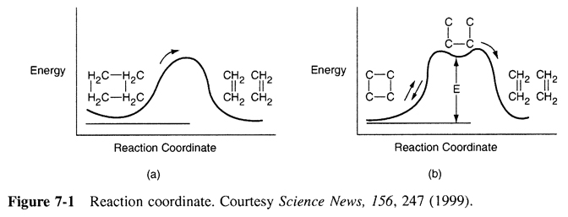
Active Intermediates and PSSH
Review Last Lecture

Slide 4
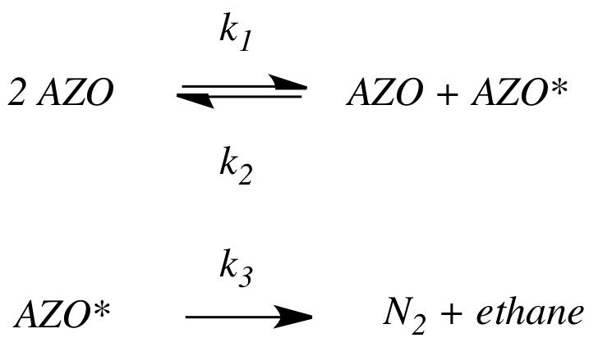
Active Intermediates and PSSH
Review Last Lecture
1.In the PSSH, we set the rate of formation of the active intermediates equal to zero. If the active intermediate A* is involved in m different reactions, we set it to:
2. The azomethane (AZO) decomposition mechanism is
By applying the PSSH to AZO*, we show the rate law, which exhibits first-order dependence with respect to AZO at high AZO concentrations and second-order dependence with respect to AZO at low AZO concentrations.

Slide 5
Enzymes
Michaelis-Menten Kinetics
Enzymes are protein-like substances with catalytic properties.
Enzyme Unease [From Biochemistry, 3/E by Stryer, copywrited 1988 by Lubert Stryer. Used with permission of W.H. Freeman and Company.]

Slide 6
Enzymes
Enzymes provide a pathway for the substrate to proceed at a faster rate. The substrate, S, reacts to form a product P.
Slow
S
P
Fast
A given enzyme can only catalyze only one reaction. Example, Urea is decomposed by the enzyme urease.

Slide 7
Enzymes - Urease
A given enzyme can only catalyze only one reaction. Urea is decomposed by the enzyme urease, as shown below.
The corresponding mechanism is:

Slide 8
Enzymes - Michaelis-Menten Kinetics

Slide 9
Enzymes - Michaelis-Menten Kinetics

Slide 10
Enzymes - Michaelis-Menten Kinetics
V_{max}=k_{cat}E_{t}
Turnover Number: k_{cat}
Number of substrate molecules (moles) converted to product in a given time (s) on a single enzyme molecule (molecules/molecule/time)
For the reaction:
k_{cat}
H₂O₂ + E →H₂O + O + E
40,000,000 molecules of H₂O₂ converted to product per second on a single enzyme molecule.

Slide 11
Enzymes - Michaelis-Menten Kinetics
Michaelis-Menten Equation
(Michaelis-Menten plot)
V_{max}
Solving:
K_{M}=S_{1/2}
therefore K_{M} is the concentration at which the rate is half the maximum rate.
-r_{s}
S_{1/2}
C_{S}

Slide 12
Enzymes - Michaelis-Menten Kinetics
Inverting yields:
Lineweaver-Burk Plot
1/-r_{S}
slope = K_{M}/V_{max}
1/V_{max}
1/S

Slide 13
Types of Enzyme Inhibition
Competitive
Uncompetitive
Non-competitive

Slide 14
Competitive Inhibition

Slide 15
Competitive Inhibition
1) Mechanisms:

Slide 16
Competitive Inhibition
2) Rate Laws:

Slide 17
Competitive Inhibition

Slide 18
Competitive Inhibition
From before (no competition):
Increasing C_{I}
Competitive
No Inhibition
Competitive
Intercept does not change, slope increases as inhibitor concentration increases

Slide 19
Uncompetitive Inhibition

Slide 20
Uncompetitive Inhibition
Inhibition only has affinity for enzyme-substrate complex
Developing the rate law:
(1)
(2)

Slide 21
Adding (1) and (2)
Uncompetitive Inhibition
From (2)

Slide 22
Uncompetitive Inhibition
Total enzyme

Slide 23
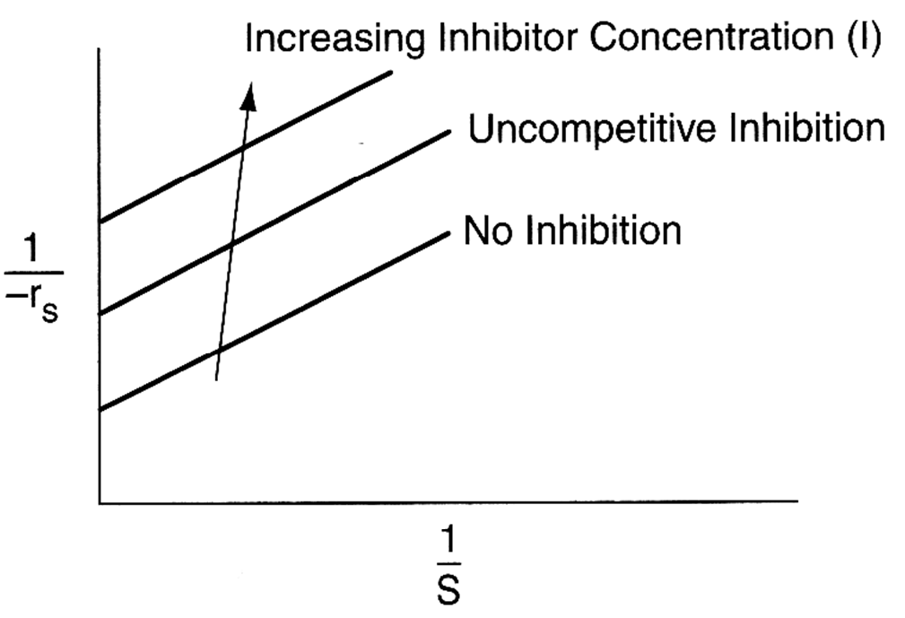
Uncompetitive Inhibition
Slope remains the same but intercept changes as inhibitor concentration is increased
Lineweaver-Burk Plot for uncompetitive inhibition

Slide 24
Non-competitive Inhibition

Slide 25
Non-competitive Inhibition
E + S E·S P + E
(inactive)I.E + S I.E.S (inactive)
+I
-I
-I
+I
Increasing I
No Inhibition
Both slope and intercept changes

Slide 26
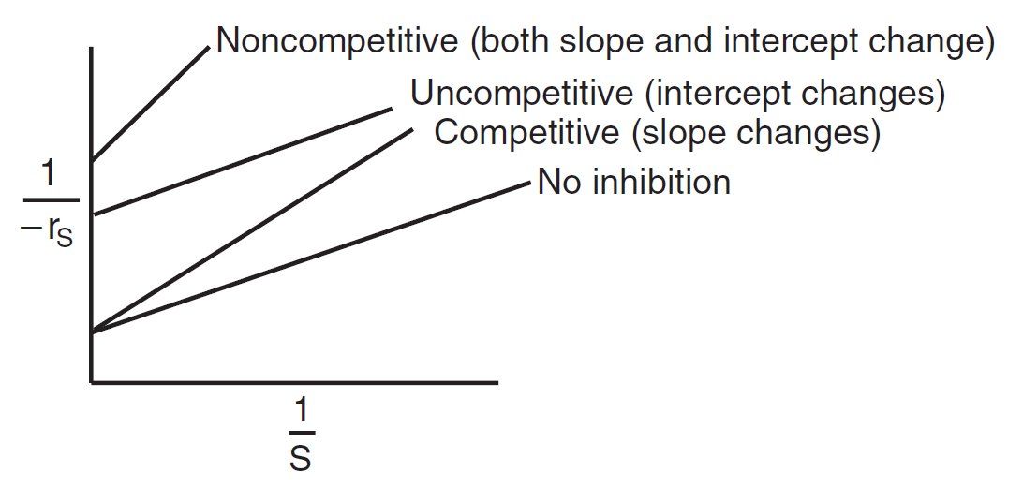
Summary: Types of Enzyme Inhibition
Lineweaver–Burk plots for three types of enzyme inhibition.

Slide 27
End of Lecture 15

