Slide 1
Lecture 6
Chemical Reaction Engineering (CRE) is the field that studies the rates and mechanisms of chemical reactions and the design of the reactors in which they take place.

Slide 2
Lecture 6 – Tuesday
Block 1: Mole Balances
Block 2: Rate Laws
Block 3: Stoichiometry
Block 4: Combine
Review of Blocks 1, 2 and 3
Examples : Undergraduate Reactor Experiments
CSTR
PFR
BR
Gas Phase Reaction with Change in the Total Number of Moles

Slide 3
Building Block 1: Mole Balances
Review Lecture 2
_{in terms of conversion, X}
Reactor | Differential | Algebraic | Integral
X
Batch
t
CSTR
PFR
X
PBR
W

Slide 4
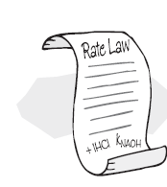
Building Block 2: Rate Laws
Review Lecture 3
Power Law Model:
A reactor follows an elementary rate law if the reaction orders just happens to agree with the stoichiometric coefficients for the reaction as written.
e.g. If the above reaction follows an elementary rate law
2nd order in A, 1st order in B, overall third order

Slide 5
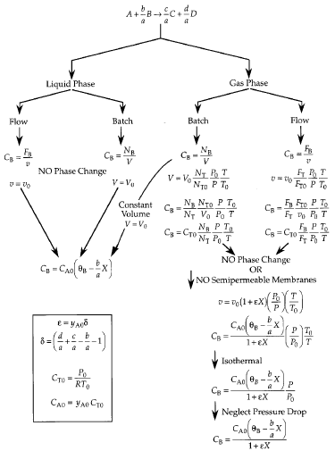
Building Block 3: Stoichiometry
Review Lecture 4

Slide 6
Review Lecture 5
Building Block 4: Combine

Slide 7
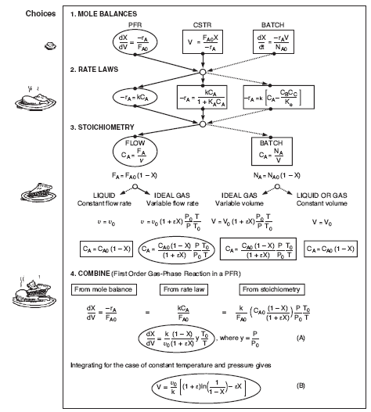
Review Lecture 5
Building Block 4:
Combine

Slide 8
Today’s lecture
Example for Liquid Phase Undergraduate Laboratory Experiment
(CH₂CO)₂O + H₂O → 2CH₃COOH
A + B → 2C
Entering
Volumetric flow rate v₀ = 0.0033 dm³/s
Acetic Anhydride 7.8% (1M)
Water 92.2% (51.2M)
Elementary with k’ 1.95x10⁻⁴ dm³/(mol.s)
Case I CSTR V = 1dm³
Case II PFR V = 0.311 dm³

Slide 9
Today’s lecture
Example for Gas Phase : PFR and Batch Calculation
2NOCl → 2NO + Cl₂
2A → 2B + C
Pure NOCl fed with C_{NOCl,0} = 0.2 mol/dm³ follows an elementary rate law with k = 0.29 dm³/(mol.s)
Case I PFR with v₀ = 10 dm3/s
Find space time, $τ$ with X = 0.9
Find reactor volume, V for X = 0.9
Case II Batch constant volume
Find the time, t, necessary to achieve 90% conversion. Compare $τ$ and t.

Slide 10
Part 1: Mole Balances in terms of Conversion
Algorithm for Isothermal Reactor Design
Mole Balances and Design Equation
Rate Laws
Stoichiometry
Combine
Evaluate
A. Graphically (Chapter 2 plots)
B. Numerical (Quadrature Formulas Chapter 2 and appendices)
C. Analytical (Integral Tables in Appendix)
D. Software Packages (Appendix- Polymath)

Slide 11
CSTR Laboratory Experiment
Example: CH₃CO₂ + H₂0 → 2CH₃OOH
A + B → 2C
1) Mole Balance: CSTR:

Slide 12
CSTR Laboratory Experiment
2) Rate Law:
3) Stoichiometry:
A | F_{A0} | -F_{A0}X | F_{A}=F_{A0}(1-X)
B | F_{A0}Θ_{B} | -F_{A0}X | F_{B}=F_{A0}(Θ_{B}-X)
C | 0 | 2F_{A0}X | F_{C}=2F_{A0}X

Slide 13
CSTR Laboratory Experiment

Slide 14
CSTR Laboratory Experiment

Slide 15
PFR Laboratory Experiment
A + B → 2C
1) Mole Balance:
2) Rate Law:
3) Stoichiometry:

Slide 16
PFR Laboratory Experiment
4) Combine:

Slide 17
Gas Flow PFR Example
2 NOCl → 2 NO + Cl₂
2A → 2B + C
1) Mole Balance:
2) Rate Law:

Slide 18
Gas Flow PFR Example
3) Stoichiometry: (Gas Flow)
A → B + ½C
4) Combine:

Slide 19
Gas Flow PFR Example

Slide 20
Constant Volume Batch Example
Gas Phase 2A → 2B + C t=?
1) Mole Balance:
2) Rate Law:
3) Stoichiometry: (Gas Flow)

Slide 21
Constant Volume Batch Example
4) Combine:

Slide 22
Heat Effects
Isothermal Design
Stoichiometry
Rate Laws
Mole Balance

Slide 23
End of Lecture 6

