Slide 1
eResearch Proposal Management
Release 1.9 System Enhancements
August 2010

Slide 2
Agenda
Release Schedule
Changes implemented to production Friday morning, August 13, 2010
System updates
PAF Changes
PAF Summary
New State
Turn Down Policy
Other Changes
Questions & Help

Slide 3
eRPM Update – PAF Changes
If PAF question 1.5 is answered, there will be validation on the Project/Grant Number.
Current question:
Future question:

Slide 4
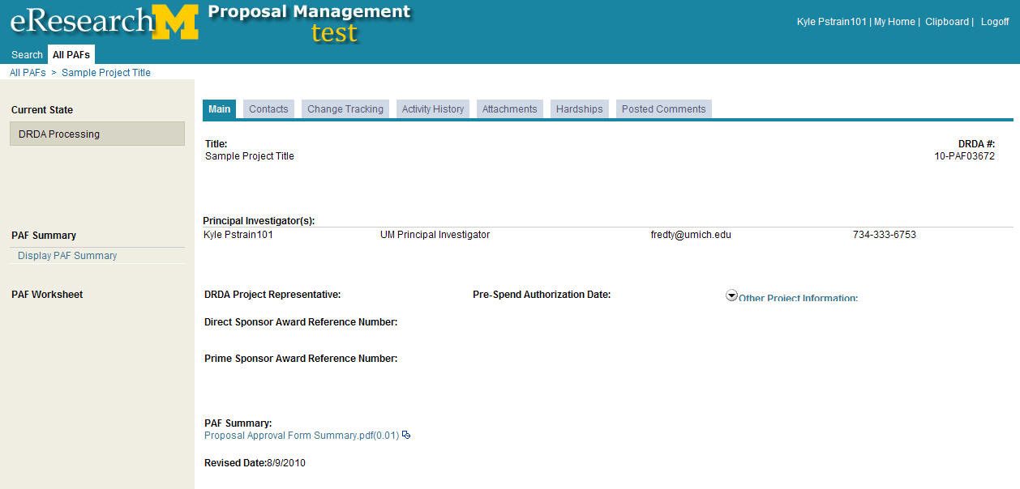
eRPM Update – PAF Summary
PDF version of the PAF Summary available on PAF workspace

Slide 5
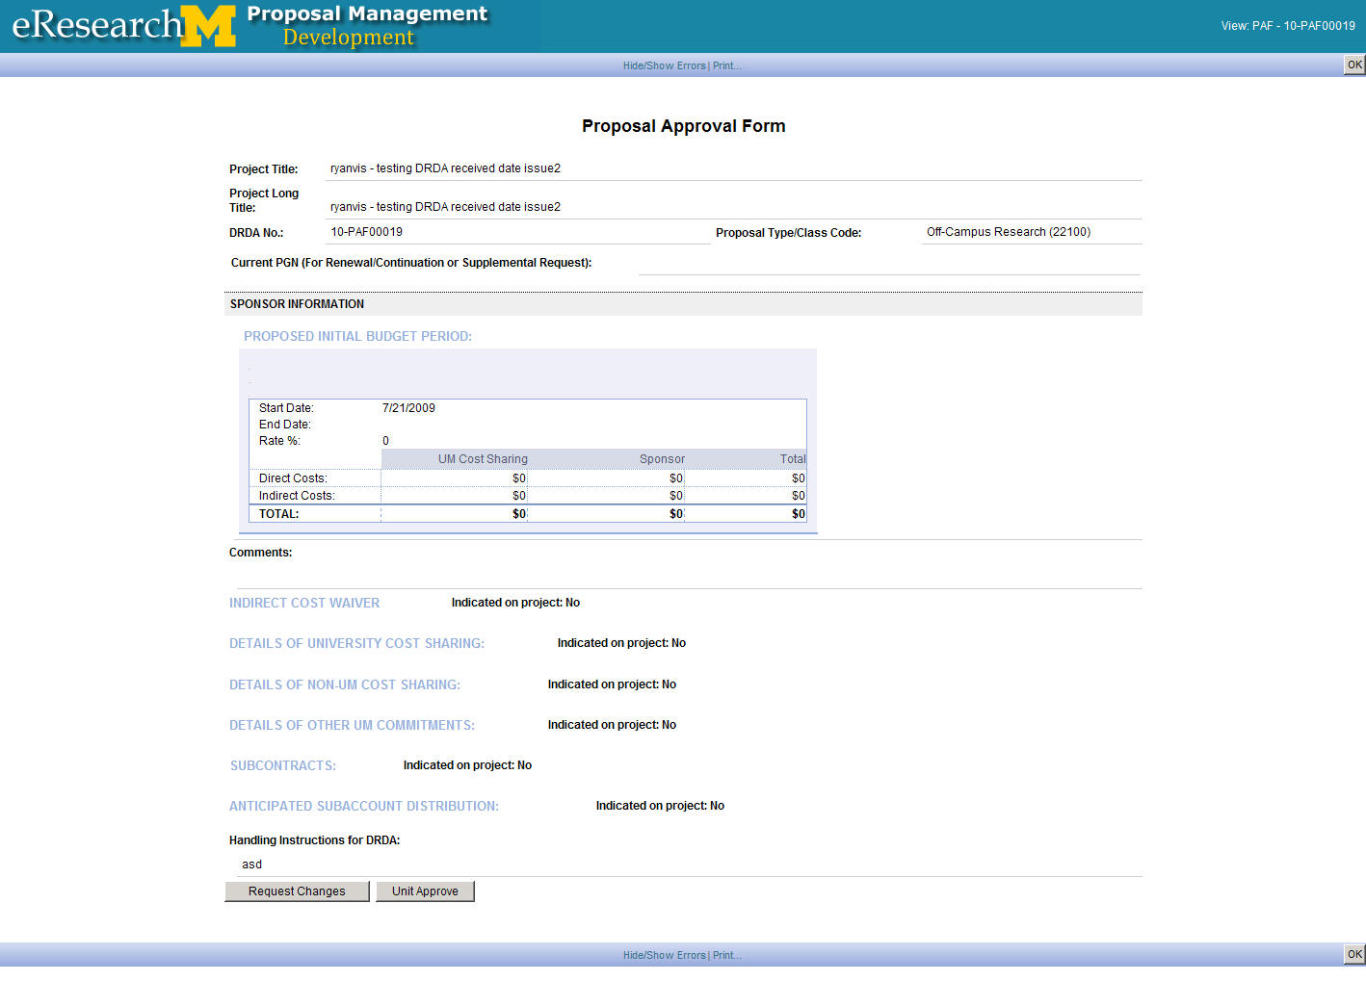
eRPM Update – PAF Summary
The long and short titles will display on the PAF Summary
All Budget Components will now display

Slide 6
eRPM Update – New State
New State: Post-Submission DRDA Approved
Current:
Future:
Submitted
to
Sponsor
Changes
Made to
PAF or
Proposal
DRDA
Admin
Review
DRDA
PR
Review
Submitted
to
Sponsor
Submitted
to
Sponsor
Changes
Made to
PAF or
Proposal
DRDA
Admin
Review
DRDA
PR
Review
Post-Submission
DRDA
Approved
Submitted
to
Sponsor

Slide 7
eRPM Update – Turn Down Policy
The system has been updated to reflect the new 18 month turn down policy
PI and Primary Research Administrator will receive email notification at 13 & 15 months
All PAF contacts will receive an email notification when a PAF is Turned Down or Withdrawn

Slide 8
eRPM Update – Turn Down Policy
If a PAF is turned down and later restored, the department signatures and PI signature(s) will be cleared and required again
Departments can request that ITS perform a bulk change to move a list of PAFs to the state of Turn Down or Withdrawn

Slide 9
eRPM Update – Other Changes
Primary research administrators will be notified when the PI signs the PAF
A new state, “Invited for Full Proposal”, has been added for Pre-Proposals (10-PRE00123)
An issue with the display of the Grants.gov link when a second submission method (in addition to “Grants.gov through eResearch”) is selected has been fixed.

Slide 10
eRPM Update – Other Changes
Two issues with the Post a Comment activity have been fixed
Inactive PIs will no longer be available for selection
Uploading a document will no longer delete selected recipients

Slide 11
Questions & Help
eRPM system support
ITS Help Desk
ITSadminhelpdesk@umich.edu or 734-764-HELP
eRPM system information and guidance
eresearch.umich.edu
http://www.umich.edu/~eresinfo/pm.html
Notes:
Bullet points from Governance document
U-M IT Executive Committee
Provost, CFO, Executive Vice President for Medical Affairs, and Vice President for Research
Set strategic direction from the highest level of the University
Make decisions on the IT strategic investments and policy
Provide communications and alignment with the Regents
Appoint the Chair of the IT Council
U-M IT Council
Develops and recommends strategic direction for shared information, communications and technologies
Seek input from stakeholders and review proposals from various representatives
Communicate Executive Council approval of recommendations back to constituencies
Review projects that align with U-M IT Strategy and prioritize
Sponsor IT Rationalization efforts and make recommendations based on findings
Endorse, decline to endorse, or ask for more information on any project before recommending to IT Executive Committee

