Slide 1
English Syntax - Greatest Hits
Spray/Load Alternation: load apples on the truck/the truck with apples
Whiz-Deletion: the man who was watching us ~ the man watching us
Pied-Piping: the man she left with ~ the man with whom she left
Verbing Nouns: seed the pepper ~ seed the lawn
Cleft Sentences: I like tacos ~ What I like is tacos ~ It’s tacos I like
Negative Polarity Items: any, ever, at all, budge, in donkey’s years
Sound Symbolism: kl-, st-, -ump, -ip
Deixis: May We Come In?

Slide 2
Spray/Load Alternation
There is a class of verbs with similar meaning – involved with placing and distributing various kinds of things – that share a grammatical rule.
This rule allows these verbs to occur with two kinds of object Noun Phrases, representing moving things, and the places they move to.
Either NP may be the direct object, but the other NP needs a preposition. She drizzled the salad with oil. ~ She drizzled oil on the salad
There is another class of similar verbs where this rule does not work. She filled the cup with water ~ *She filled water into the cup.

Slide 3
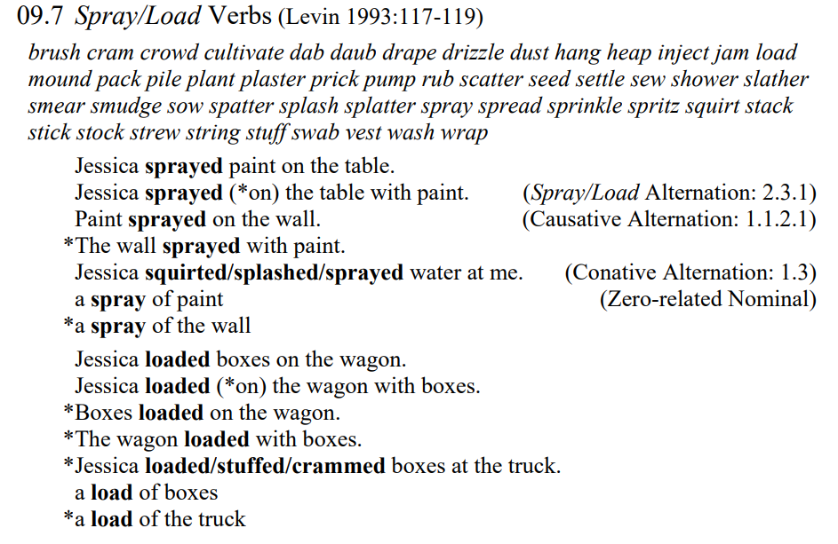
Spray/Load Alternation

Slide 4
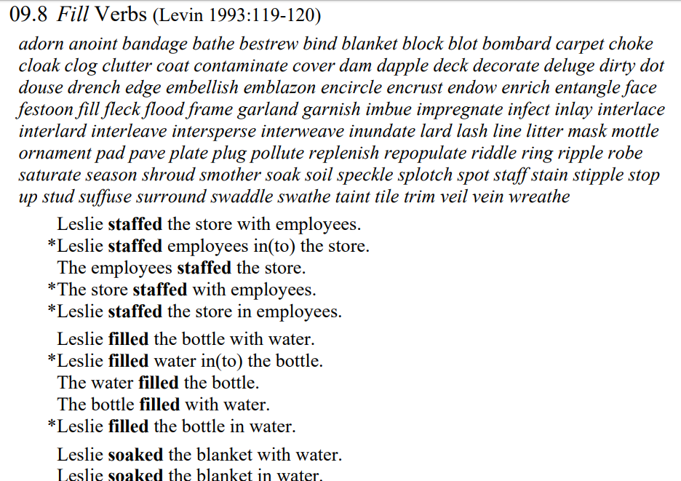

Slide 5
Whiz-Deletion
Relative clauses usually begin with a Wh-word (which, who, where, etc.) the man who is coming to dinner, the bridge which is standing there
If the wh-word is the subject of the relative clause, and if the first auxiliary verb is a form of be (as in the examples above), they may be deleted together by the rule of Whiz-Deletion: the man coming to dinner, the bridge standing there
Whiz-Deletion is extremely common; it’s the source of most participles and prepositional phrases following the nouns they modify: an iron in the fire, the last man standing, a tree 250 years old

Slide 6
Pied-Piping
A wh-word can be the subject of a relative clause, or an object of a verb or preposition: a book which she read __, a man whom she talked to __
A preposition in a relative clause with a wh-word as object may optionally be moved to the front, along with its object: a man to whom she talked
This movement of extra material with the wh-word in a relative clause is referred to as “Pied-Piping” the material; this can get quite extensive:
the books which the Chair decides on the lettering in the titles of the books of which the Chair decides on the lettering in the titles the books in the titles of which the Chair decides on the lettering the books the lettering in the titles of which the Chair decides on

Slide 7
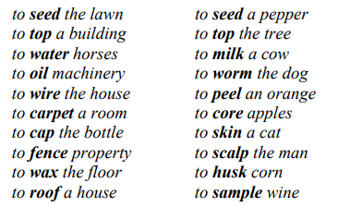
Verbing Nouns

Slide 8
Cleft Sentences
Any sentence can be expanded to indicate emphasis and viewpoint. Of the many rules with that function, a number are called Clefts because they divide the sentence into two parts balanced on a fulcrum.
Usually a dummy element like it or what is involved:
It-clefts: It was Bill that/who passed the math test It was the math test that/which Bill passed
Wh-clefts: What Bill passed was the math test What Bill did was pass the math test

Slide 9
Negation and Negative Polarity
Negative Polarity words and phrases only occur in a negative context: She hasn’t ever been there ~ *She has ever been there. She hasn’t been there in weeks ~ *She has been there in weeks She refused to budge an inch ~ *She agreed to budge an inch
Negative Triggers are words, phrases, and constructions that license NPIs Few have seen it at all ~ *A few have seen it at all She doubts he’s all that smart~ *She claims he’s all that smart It rarely takes long to do ~ *It often takes long to do Only Bill has arrived yet ~ *Even Bill has arrived yet Has Bill arrived yet? ~ *Bill has arrived yet (NPIs are OK in questions)

Slide 10
Sound Symbolism
Monosyllabic words like sting, clip, black, and plump have two parts:
Assonance: st-, kl-, bl-, and pl- + Rime: -ing, -ip, -æk, and -əmp
Sometimes these word chunks have meanings and can combine:
clip, close, clump, cling, and others – things that go together
stiff, stack, sting, stump, and others – (vertical) 1-Dimensional things
blood, bloat, blimp, blast, and others – contained fluid
plump, plaque, plank, pleat, and others – 2-D thick things
hump, bump, sump, slump, and others – 3-D concave or convex things
blip, flip, dip, lip, and others – small 3-D parts of 2-D things

Slide 11
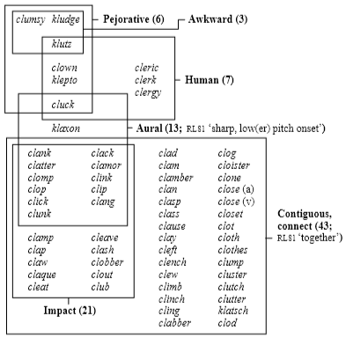
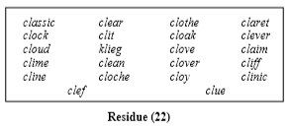
84 Simplex Words with Assonance KL-
Coherence 62/84 = 74%

Slide 12
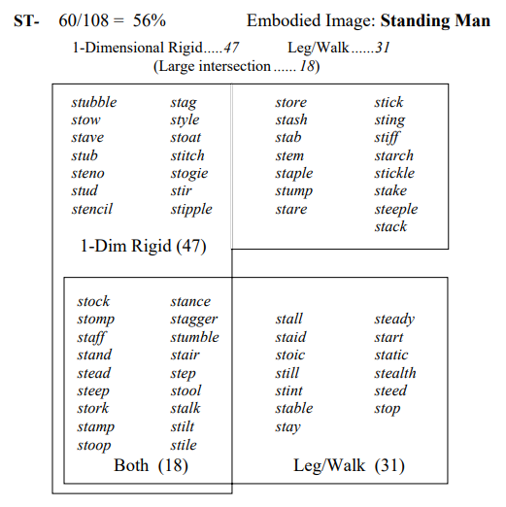

Slide 13
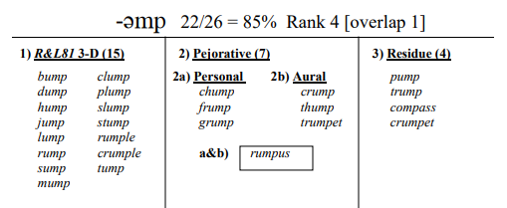
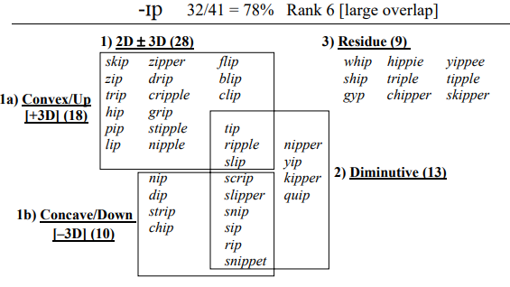

Slide 14
Deixis
May We Come In?
May
We
Come
In
?

