Slide 1
Identifiability of linear compartmental models
Nicolette Meshkat
North Carolina State University
Parameter Estimation Workshop – NCSU
August 9, 2014
78 slides

Slide 2



Structural Identifiability Analysis
Linear Model:
  state variable
  input
  output
  matrices with unknown parameters
Finding which unknown parameters of a model can be quantified from given input-output data

Slide 3
But why linear compartment models?
Used in many biological applications, e.g. pharmacokinetics
Very often unidentifiable!
Nice algebraic structure
  Can actually prove some general results!

Slide 4
Unidentifiable Models
Question 1: Can we always “reparametrize” an unidentifiable model into an identifiable one?

Slide 5
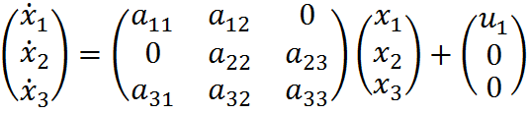

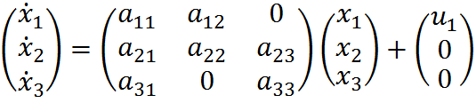
Motivation: Question 1
Model 1:
Model 2:

Slide 6
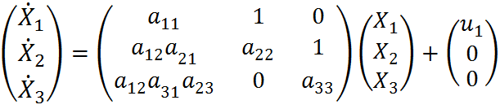

Motivation: Question 1
Model 1: No ID scaling reparametrization!
Model 2: ID scaling reparametrization:

Slide 7
Unidentifiable Models
Question 1: Can we always “reparametrize” an unidentifiable into an identifiable one?
Question 2: If a reparametrization exists, can we instead modify the original model to make it identifiable?

Slide 8
Motivation: Question 2
Model 2:
Starting with Model 2, how should we adjust model to obtain identifiability?
  Decrease # of parameters?
  Add input/output data?

Slide 9

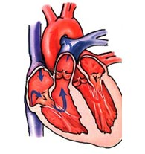
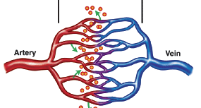
Motivation: biological models
Measured drug
concentration
Drug
input
Drug exchange
Loss from blood
Loss from organ
Notes:
Here example of simple bio model. In a lab, studying effects of a drug on the human body. Drug is admistered in the blood, “input”. Then drug is exchanged, leaves the system. Then after some time, the biologist measures the drug concentration in the blood, “output”. Important point: only know input/output, other arrows are unknown quantites, unknown parameters.

Slide 10

Example: Linear 2-Compartment Model
y
u₁
x₁
k₂₁
x₂
k₁₂
k₀₁
k₀₂

Slide 11




Linear Compartment Models
System equations:
Can change to form

Slide 12

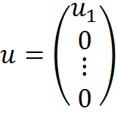

Larger class of models to investigate
Assumptions:
  I/O in first compartment
  Leaks from every compartment
where and diagonal elements =

Slide 13
Useful tool: Directed Graph
A directed graph G is a set of:
  Vertices
  Edges
Ex 1:
  Vertices: {1, 2}
  Edges: {1 2, 2 1}
1
2

Slide 14
Useful tool: Directed Graph
A directed graph G is a set of:
  Vertices
  Edges
Ex 2:
  Vertices: {1, 2, 3}
  Edges: {1 2, 2 1, 2 3}
A graph is strongly connected if there exists a path from each vertex to every other vertex
1
2
3

Slide 15
Useful tool: Directed Graph
A directed graph G is a set of:
  Vertices
  Edges
Ex 3:
  Vertices: {1, 2, 3}
  Edges: {1 2, 2 1, 2 3, 3 1}
A graph is strongly connected if there exists a path from each vertex to every other vertex
1
2
3

Slide 16
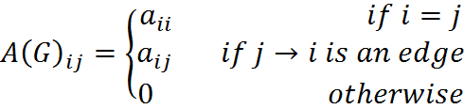

Convert to graph
Let G be directed graph with m edges, n vertices
Associate a matrix A to the graph G:
where each is an independent real parameter
Look only at strongly connected graphs

Slide 17



2-compartment model as graph
Model:
Graph:
1
2
Cycle:
“Self” cycles:

Slide 18

Identifiability Analysis
Model:
Unknown parameters:
Identifiability: Which parameters of model can be quantified from given input-output data?
  Must first determine input-output equation

Slide 19

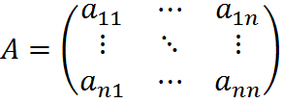
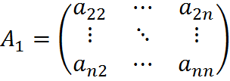

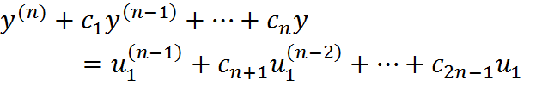
Find Input-Output Equation
Rewrite system eqns as
Cramer’s Rule:
I/O eqn:

Slide 20
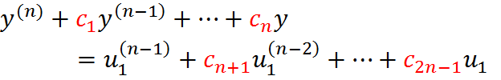
Identifiability
Can recover coefficients from data
Identifiability: is it possible to recover the parameters of the original system, from the coefficients of I/O eqn?
  Two sets of parameter values yield same coefficient values?
  Is coeff map 1-to-1?

Slide 21



2-compartment model
I/O eqn
Coefficient map
Identifiability: Is the coefficient map 1-to-1?
No!

Slide 22

Identifiability from I/O eqns
Question of injectivity of the coefficient map
If c is one-to-one: globally identifiable
finite-to-one: locally identifiable
infinite-to-one: unidentifiable

Slide 23






One-to-one Example
Map
2 equations:
One-to-one:

Slide 24




Finite-to-one Example
Map
2 equations:
Finite-to-one:
or

Slide 25




Our example
3 equations:
Infinite-to-one!

Slide 26



Our example
3 equations:
Infinite-to-one!

Slide 27


Testing identifiability in practice
Check dimension of image of coefficient map
If dim im c = m+n, then locally identifiable
If dim im c < m+n, then unidentifiable
Linear Ex:
Jacobian has rank 2:

Slide 28
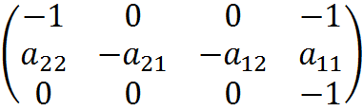
Testing identifiability in practice
Check dimension of image of coefficient map
If dim im c = m+n, then locally identifiable
If dim im c < m+n, then unidentifiable
Our Ex:
Jacobian has rank 3:

Slide 29




Unidentifiable models
Cannot determine individual parameters, but can we determine some combination of the parameters?
Ex: or
A function is called identifiable from c if
Notes:
Add equivalent slide

Slide 30







Identifiable functions
Coefficients:
Identifiable functions (cycles):
Coefficients can be written in terms of identifiable functions:

Slide 31


Unidentifiable model
Model
Identifiable functions
i.e.
Reparametrize: 4 independent parameters 3 independent parameters?

Slide 32




Identifiable reparametrization
Let be a coefficient map
An identifiable reparametrization of a model is a map such that:
has the same image as
is identifiable (finite-to-one)

Slide 33






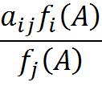
Scaling reparametrization
Choice of functions where we replace with
Set since is observed
Since model is , each parameter is replaced with
Only graphs with at most 2n-2 edges

Slide 34






Reparametrize original model
Use scaling:
Re-write:
Map has same image as and is 1-to-1

Slide 35
Motivation: Unidentifiable models
Model 1: No ID scaling reparametrization!
Model 2: ID scaling reparametrization:
2
1
3
2
1
3

Slide 36
Main question:
Which graphs with 2n-2 edges admit an identifiable scaling reparametrization?

Slide 37

Main result ¹ :
Let G be a strongly connected graph. Then TFAE:
The model has an identifiable scaling reparametrization
The model has an identifiable scaling reparametrization by monomial functions of the original parameters
All the monomial cycles in G are identifiable functions
dim im c = m+1
¹ N. Meshkat and S. Sullivant, Identifiable reparametrizations of linear compartment models, Journal of Symbolic Computation 63 (2014) 46-67.

Slide 38
Non-Example: Model 1
2
Model:
dim im c = 4, so no ID scaling reparametrization!
1
3

Slide 39
Example: Model 2
2
Model:
Identifiable cycles:
1
3

Slide 40
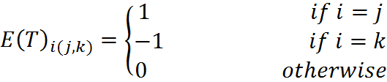

Algorithm to find identifiable reparametrization
Form a spanning tree T
Form the directed incidence matrix E(T):
Let E be E(T) with first row removed
Columns of E⁻¹ are exponent vectors of monomials in scaling

Slide 41
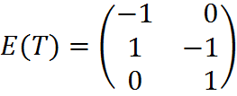




Identifiable reparametrization
2
Spanning tree
Rescaling:
Identifiable scaling reparametrization
1
3

Slide 42
Main result
A model with
  I/O in first compartment
  n leaks
  Strongly connected graph G
has an identifiable scaling reparametrization
all the monomial cycles are identifiable
dim im c = m+1
Notes:
Put a link to paper

Slide 43
Which graphs have this property?
Inductively strongly connected graphs when m=2n-2
Good:
Not complete characterization:
2
3
2
3
Bad:
1
4
1
4
2
3
1
4
Notes:
Inductively strongly connected 2 slides

Slide 44
Unidentifiable Models
Question 1: Can we always “reparametrize” an unidentifiable into an identifiable one?
Question 2: If a reparametrization exists, can we instead modify the original model to make it identifiable?

Slide 45
Model 2
Input/Output in compartment 1
Leaks from every compartment
dim im c = m+1 = 5
Identifiable cycles
2
1
3

Slide 46
Obtaining Identifiability
Starting with Model 2, how should we adjust model to obtain identifiability?
Two options: Remove leaks or add input/output
2
1
3
Notes:
When I say adjust the model, I don’t mean using it for the same biological application, I mean considering the full set of models that have the same graph structure, can I find some conditions on the placement of the inputs/outputs/leaks to yield identifiability?

Slide 47
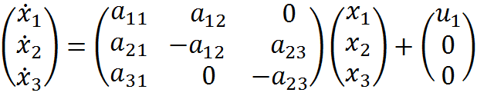

Removing leaks
2
Remove 2 leaks
dim im c = 5
1
3

Slide 48

Theorem on Removing leaks ²
Starting with a model with:
  I/O in first compartment
  n leaks
  Strongly connected graph G
  dim im c = m+1
Remove n-1 leaks Local identifiability
Ex:
2
3
1
4
² N. Meshkat, S. Sullivant, and M. Eisenberg, Identifiability results for several classes of linear compartment models, In preparation.

Slide 49
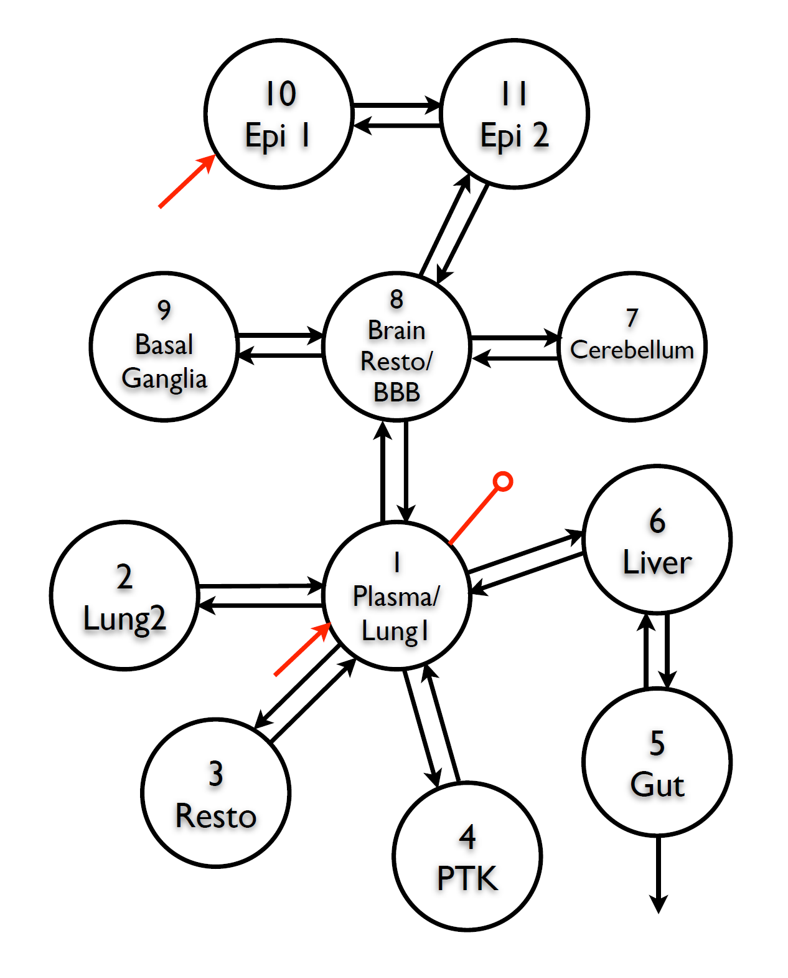
Example: Manganese Model ³
³ P. K. Douglas, M. S. Cohen, and J. J. DiStefano III, Chronic exposure to Mn inhalation may have lasting effects: A physiologically-based toxico-kinetic model in rats, Toxicology and Environmental Chemistry 92 (2) (2010) 279-299.

Slide 50
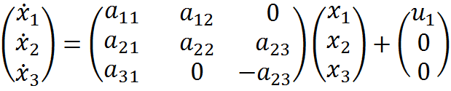


Adding output to leak compartment
Remove 1 leak and add 1 output to leak compartment
dim im c = 6
2
1
3

Slide 51
Thm: Removing leaks and adding inputs/outputs
Starting with a model with:
  I/O in first compartment
  n leaks
  Strongly connected graph G
  dim im c = m+1
Remove a subset of leaks so that every leak compartment has either input or output Local identifiability
Ex:
2
3
1
4

Slide 52
Sufficient, not necessary
Harder to find general conditions if I/O not in leak compartment
Identifiable Not identifiable
2
2
1
3
1
3

Slide 53
Quiz!
Which of the following models are identifiable?
(A) (B) (C)
Answer: B and C
1
2
1
2
1
2
Notes:
To motivate this, here are three examples of linear compartment models. I’ll discuss the notation used in these diagrams on the next slide, but for now, the motivating question is: Which of these models are identifiable? And more importantly, do they belong to a special class of models that yield identifiability?

Slide 54

Identifiability Problem for Nonlinear Models
What is our model is nonlinear?
Same process:
  Find I/O equations
  Test injectivity of coefficient map
Notes:
18 min up to here

Slide 55
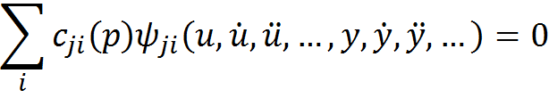
Identifiability Problem for Nonlinear Models
What is our model is nonlinear?
Same process:
  Find I/O equations
  Test injectivity of coefficient map

Slide 56



Example: Nonlinear 2-Compartment Model
y
u
x₁
k₂₁
x₂
k₁₂
k₀₂

Slide 57
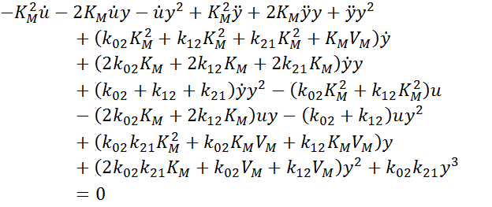
Nonlinear 2-compartment model
I/O eqn

Slide 58
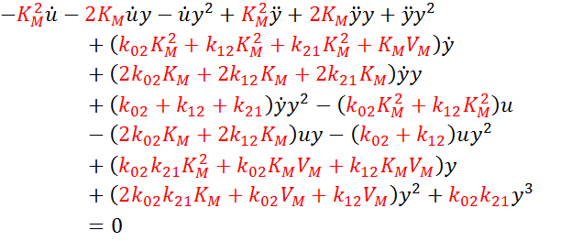
Nonlinear 2-compartment model
I/O eqn
Globally identifiable

Slide 59
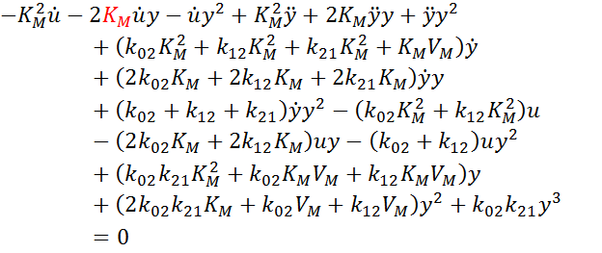
Nonlinear 2-compartment model
I/O eqn
Globally identifiable

Slide 60
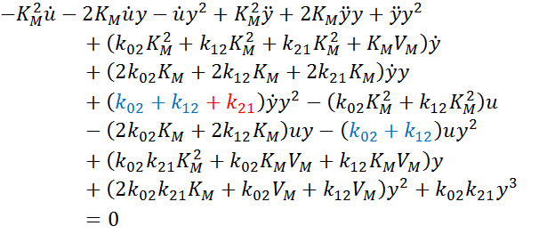
Nonlinear 2-compartment model
I/O eqn
Globally identifiable

Slide 61
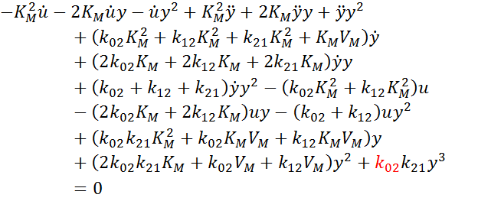
Nonlinear 2-compartment model
I/O eqn
Globally identifiable

Slide 62
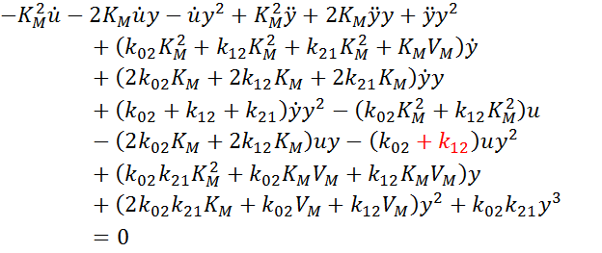
Nonlinear 2-compartment model
I/O eqn
Globally identifiable

Slide 63
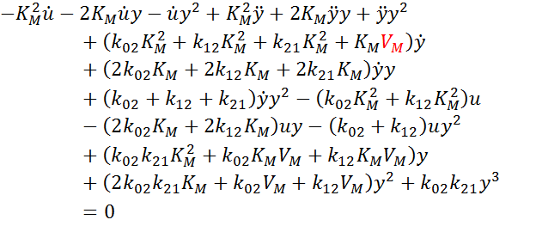
Nonlinear 2-compartment model
I/O eqn
Globally identifiable

Slide 64
Differential algebra
How to find I/O equations for nonlinear models?
Differential elimination
  Differentiation + Gröbner Basis
  Differential Gröbner Basis
    Rosenfeld-Gröbner in Maple
  Ritt’s pseudo-division
Notes:
20 min up to here

Slide 65


Example on Lotka-Volterra
Equations:
Commands in Maple:

Slide 66
Example on Lotka-Volterra
Equations:
Rosenfeld-Gröbner gives:

Slide 67






Example: Nonlinear HIV Model ⁴
Model equations:
Parameter vector:
⁴ X. Xia and C. H. Moog, Identifiability of nonlinear systems with application to HIV/AIDS models, IEEE Trans Autom Contr 48 (2003), 330-336.
Notes:
Population of uninfected cells, latently infected cells, actively infected cells, free virus particles

Slide 68

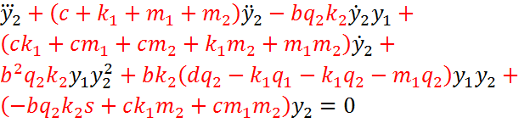

Input-Output equations
Rosenfeld-Gröbner gives two equations:
Coefficient map
  Unidentifiable!

Slide 69



How to find identifiable functions?
Injectivity test: If , does ?
Amounts to solving a system of polynomial equations
Find Gröbner Basis of
  Gives system of equations in “triangular form”
    Analogous to Gaussian elimination for systems of linear equations
  Must give an “ordering” of parameters to do the elimination

Slide 70


Example of Gröbner Basis
Set up , for
Gröbner basis for

Slide 71


Algorithm ⁵
Find Gröbner Bases of for different orderings of the parameter vector
Look for elements of the form in Gröbner Basis
Implies is identifiable
Must find N identifiable functions in order to reparametrize, where N = dim im c
⁵ N. Meshkat, M. Eisenberg, and J. J DiStefano III, An algorithm for finding globally identifiable parameter combinations of nonlinear ODE models using Groebner Bases, Math. Biosci. 222 (2009)

Slide 72
Examine Gröbner Bases

Slide 73






Identifiable Functions
ID parameters:
  Globally identifiable (one solution)
  Locally identifiable (three solutions)
ID parameter combinations:
  Globally identifiable (one solution)
  Locally identifiable (three solutions)

Slide 74




Identifiable Reparametrization
Identifiable:
Use scaling:

Slide 75
Implementation: COMBOS
Collaboration with Christine Kuo, Joe DiStefano III (UCLA)
Finds identifiable combinations for unidentifiable models
    http://biocyb1.cs.ucla.edu/combos

Slide 76
Available software to test identifiability
Differential Algebra Methods:
  DAISY
    Available online at http://www.dei.unipd.it/~pia
  COMBOS
    Soon available at http://biocyb1.cs.ucla.edu/combos
Other methods:
  GenSSI
    Available online at http://www.iim.csic.es/~genssi/
Notes:
39 min up to here

Slide 77
Acknowledgements
Collaborators:
  Seth Sullivant (NCSU)
  Marisa Eisenberg (Univ. of Michigan)
  Joe DiStefano III (UCLA)
  Christine Kuo (Harvard)

Slide 78
Summary
Nec. and suff. for identifiable scaling reparam
Suff. conditions for obtaining identifiability
Algorithm to find identifiable functions in nonlinear models using Gröbner Bases
COMBOS
Thank you for your attention!

