Slide 1
Gamma rays from dark matter in the Galactic center and IN The inner galaxy
Dan Hooper - Fermilab/University of Chicago University of Michigan Dark Matter Workshop, April 15 ^{th}, 2013

Slide 2
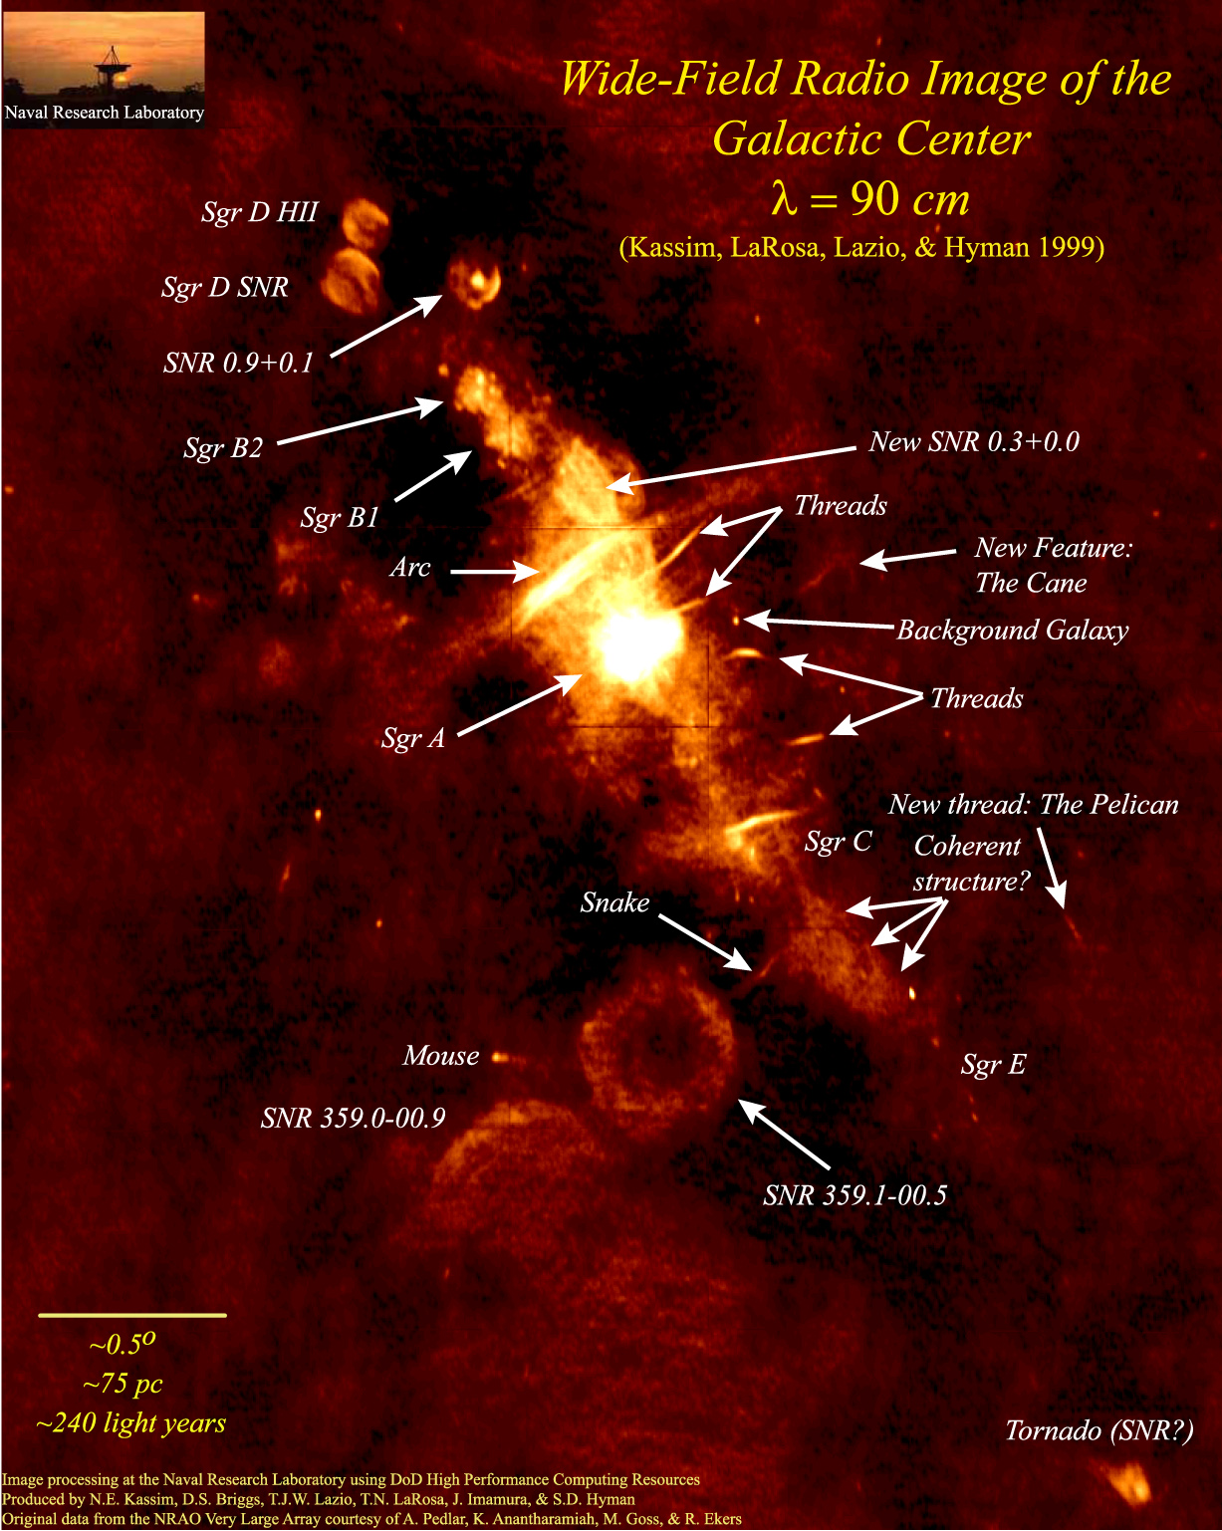
Dark Matter in The Galactic Center
The volume surrounding the Galactic Center is complex; backgrounds present are not necessarily well understood
This does not, however, make searches for dark matter region intractable
The flux of gamma rays predicted from dark matter annihilations around the Galactic Center is very large – tens of thousands of times brighter than that predicted from the brightest dwarf galaxies

Slide 3
Our Simple (but effective) Approach to the Galactic Center
1) Start with a raw map (smoothed out over 0.5° circles)
Hooper and Linden, PRD,
arXiv:1110.0006

Slide 4
Our Simple (but effective) Approach to the Galactic Center
1) Start with a raw map (smoothed out over 0.5° circles)
2) Subtract known point sources (Fermi 2nd source catalog)
Hooper and Linden, PRD,
arXiv:1110.0006

Slide 5
Our Simple (but effective) Approach to the Galactic Center
1) Start with a raw map (smoothed out over 0.5° circles)
2) Subtract known point sources (Fermi 2nd source catalog)
3) Subtract line-of-sight gas density template (empirical, good match to 21-cm)
Hooper and Linden, PRD,
arXiv:1110.0006

Slide 6
Our Simple (but effective) Approach to the Galactic Center
This method removes ~90% of the emission in the inner galaxy (outside of the innermost few degrees)
Typical residuals are ~5% or less as bright as the inner residual – spatial variations in backgrounds are of only modest importance
Clearly isolates the emission associated with the inner source or sources (supermassive black hole? Dark matter? Pulsars?), along with a subdominant component of “ridge” emission
Hooper and Linden, PRD,
arXiv:1110.0006

Slide 7
Characteristics of the Observed Gamma Ray Residual
1) The spectrum peaks between ~300 MeV and ~10 GeV
Hooper and Linden, PRD,
arXiv:1110.0006

Slide 8
Characteristics of the Observed Gamma Ray Residual
1) The spectrum peaks between ~300 MeV and ~10 GeV
2) Clear spatial extension – only a small fraction of the emission above ~300 MeV is point-like
Hooper and Linden, PRD,
arXiv:1110.0006

Slide 9
Characteristics of the Observed Gamma Ray Residual
1) The spectrum peaks between ~300 MeV and ~10 GeV
2) Clear spatial extension – only a small fraction of the emission above ~300 MeV is point-like
3) Good agreement is found between our analysis and those of other groups (see the recent analysis by Abazajian and Kaplinghat, for example)
Hooper and Linden, PRD,
arXiv:1110.0006

Slide 10
The Dark Matter Interpretation
The extended emission residual can be explained by annihilating dark matter with the following characteristics:
The spectral shape of the residual is well fit by a dark matter particle with a mass in the range of 7 to 12 GeV, annihilating primarily to τ⁺τ⁻ (possibly among other leptons), or with a mass of 22 to 45 GeV annihilating to quarks
The angular distribution of the signal is well fit by a halo profile with an inner slope of γ~1.25 to 1.4 (in agreement with expectations from simulations)
The normalization of the signal requires a low-velocity annihilation cross section of σv ~ 10⁻²⁶ -10⁻²⁷ cm³/s (up to uncertainties in the profile normalization, etc.); similar to expectations for a thermal relic
Hooper and Linden, PRD, arXiv:1110.0006

Slide 11
Astrophysical Interpretation 1
Pion Decay Gamma Rays From Cosmic Rays Accelerated by the Supermassive Black Hole?
The observed emission (above ~300 MeV) is spatially extended, and does not originate directly from the SMBH
But protons accelerated by or nearby the SMBH could propagate outward, leading to an extended gamma ray signal

Slide 12
Astrophysical Interpretation 1
Pion Decay Gamma Rays From Cosmic Rays Accelerated by the Supermassive Black Hole?
The observed emission (above ~300 MeV) is spatially extended, and does not originate directly from the SMBH
But protons accelerated by or nearby the SMBH could propagate outward, leading to an extended gamma ray signal
The spectrum of the extended emission, however, rises very rapidly between 100 MeV and 1 GeV;
Much more so than the spectrum from proton collisions (for any proton spectrum)
This is not what gamma rays from pion decay should look like
Note: If only photons above 1 GeV are studied, much of this emission could be interpreted as pion decay gammas – sub-GeV emission is essential to distinguish between CR-gas and DM origins
Boyarsky et al., arXiv:1012.5839

Slide 13
Astrophysical Interpretation 1
Pion Decay Gamma Rays From Cosmic Rays Accelerated by the Supermassive Black Hole?
Furthermore, the morphology of the gamma ray signal is largely determined by the distribution of gas, and will be dominated by the circum-nuclear ring that is known to be present within ~1-3 pc of the Galactic Center
To Fermi, this emission should appear point-like (3 pc is equivalent to ~0.02°)
The observed morphology of the gamma-ray emission is extended over a region of at least 50-100 pc, and likely much larger, this is strongly inconsistent with the known distribution of gas
Linden, Lovegrove, Profumo, arXiv:1203.3539;
See also Linden and Profumo, arXiv:1206.4308

Slide 14
Astrophysical Interpretation 2
A Collection of Unresolved Pulsars
Perhaps a large population of unresolved points sources distributed throughout the inner tens of parsecs of the Milky Way could produce the observed signal; a collection of ~10³ millisecond pulsars, for example

Slide 15
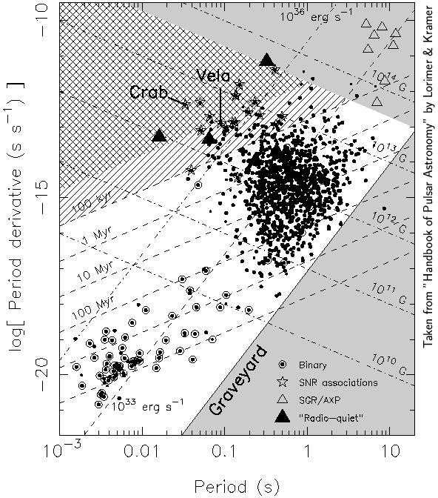
Pulsar Basics
Ordinary Pulsars
Pulsars are rapidly spinning neutron stars, which gradually convert their rotational kinetic energy into radio and gamma ray emission

Slide 16
Pulsar Basics
Ordinary Pulsars
Pulsars are rapidly spinning neutron stars, which gradually convert their rotational kinetic energy into radio and gamma ray emission
Typical pulsars exhibit periods on the order of ~1 second and slow down at a rate that implies the presence ~10¹² Gauss magnetic fields

Slide 17
Pulsar Basics
Ordinary Pulsars
Pulsars are rapidly spinning neutron stars, which gradually convert their rotational kinetic energy into radio and gamma ray emission
Typical pulsars exhibit periods on the order of ~1 second and slow down at a rate that implies the presence ~10¹² Gauss magnetic fields
Over ~10⁶ -10⁸ years, pulsars lose most of their rotational energy and become faint

Slide 18
Pulsar Basics
Ordinary Pulsars
Pulsars are rapidly spinning neutron stars, which gradually convert their rotational kinetic energy into radio and gamma ray emission
Typical pulsars exhibit periods on the order of ~1 second and slow down at a rate that implies the presence ~10¹² Gauss magnetic fields
Over ~10⁶ -10⁸ years, pulsars lose most of their rotational energy and become faint
Millisecond Pulsars (aka Recycled Pulsars)
Some pulsars have binary companions (although most are lost from velocity kicks)
If a companion of a pulsar evolves into a red giant, accretion can “spin-up” the pulsar’s period to as short as ~1.5 msec, and with much lower magnetic fields (~10⁸-10⁹ G) and much slower spin-down timescales than are found among ordinary pulsars – can remain bright for >10⁹ years

Slide 19
Millisecond Pulsars as the Source of the Galactic Center Signal?
Millisecond Pulsars (MSPs) are better suited to account for the Galactic Center gamma rays for two reasons:

Slide 20
Millisecond Pulsars as the Source of the Galactic Center Signal?
Millisecond Pulsars (MSPs) are better suited to account for the Galactic Center gamma rays for two reasons:
1) MSPs remain bright for billions of years, and thus ancient periods of rapid star formation might have produced a large number of such objects in the Galactic Center; there should not be enough ordinary pulsars in the Galactic Center to account for the signal

Slide 21
Millisecond Pulsars as the Source of the Galactic Center Signal?
Millisecond Pulsars (MSPs) are better suited to account for the Galactic Center gamma rays for two reasons:
1) MSPs remain bright for billions of years, and thus ancient periods of rapid star formation might have produced a large number of such objects in the Galactic Center; there should not be enough ordinary pulsars in the Galactic Center to account for the signal
2) When pulsars are formed, they typically obtain “kicks” of several hundred km/s as a result of asymmetric collapse – sufficient to expel the vast majority of pulsars from the gravitational potential of the Galactic Center
But MSPs retained their binary companion, and thus must have had exceptionally weak kicks; and those kicks were also weighed down by the mass of their companion – this is why so many MSPs are found in globular clusters (130 known)

Slide 22
Gamma Ray Observations of Millisecond Pulsars
The Fermi Collaboration has identified 47 pulsars with millisecond-scale periods; 37 of which have spectra reported in the 2-year Fermi source catalog (2FGL)
The combined spectrum of these 37 sources is very well described by a spectrum with a power-law index of 1.3-1.4 and an exponential cutoff at 2.5-3.0 GeV
DH and collaborators, in progress

Slide 23
Gamma Ray Observations of Millisecond Pulsars
The Fermi Collaboration has identified 47 pulsars with millisecond-scale periods; 37 of which have spectra reported in the 2-year Fermi source catalog (2FGL)
The combined spectrum of these 37 sources is very well described by a spectrum with a power-law index of 1.3-1.4 and an exponential cutoff at 2.5-3.0 GeV
This is considerably less sharply peaked than is observed from the Galactic Center (spectral index of ~0.5 instead of ~1.35)
MSPs
10 GeV DM, τ⁺τ⁻
DH and collaborators, in progress

Slide 24
Gamma Ray Observations of Millisecond Pulsars
The Fermi Collaboration has identified 47 pulsars with millisecond-scale periods; 37 of which have spectra reported in the 2-year Fermi source catalog (2FGL)
The combined spectrum of these 37 sources is very well described by a spectrum with a power-law index of 1.3-1.4 and an exponential cutoff at 2.5-3.0 GeV
This is considerably less sharply peaked than is observed from the Galactic Center (spectral index of ~0.5 instead of ~1.35)
In fact, none of these 37 sources appears to have a much harder spectral index
MSPs
10 GeV DM, τ⁺τ⁻
DH and collaborators, in progress

Slide 25
Gamma Ray Observations of Millisecond Pulsars
The Fermi Collaboration has identified 47 pulsars with millisecond-scale periods; 37 of which have spectra reported in the 2-year Fermi source catalog (2FGL)
The combined spectrum of these 37 sources is very well described by a spectrum with a power-law index of 1.3-1.4 and an exponential cutoff at 2.5-3.0 GeV
This is considerably less sharply peaked than is observed from the Galactic Center (spectral index of ~0.5 instead of ~1.35)
In fact, none of these 37 sources appears to have a much harder spectral index
And globular clusters (whose gamma ray emission is believed to be dominated by MSPs) reveal no indications of a much harder spectrum, although errors are large (also, ordinary pulsars exhibit average spectra that are almost identical to MSPs)
MSPs
10 GeV DM, τ⁺τ⁻
DH and collaborators, in progress

Slide 26
Three Common Perspectives, Circa 2012

Slide 27
Three Common Perspectives, Circa 2012
The Dark Matter Enthusiast – These arguments look compelling; the extended GeV gamma ray excess from the Galactic Center probably comes from dark matter annihilations

Slide 28
Three Common Perspectives, Circa 2012
The Dark Matter Enthusiast – These arguments look compelling; the extended GeV gamma ray excess from the Galactic Center probably comes from dark matter annihilations
The Pulsar Enthusiast – The signal is there and requires an explanation, but (millisecond) pulsars are at least as likely as dark matter

Slide 29
Three Common Perspectives, Circa 2012
The Dark Matter Enthusiast – These arguments look compelling; the extended GeV gamma ray excess from the Galactic Center probably comes from dark matter annihilations
The Pulsar Enthusiast – The signal is there and requires an explanation, but (millisecond) pulsars are at least as likely as dark matter
The Galactic Center Pessimist – The Galactic Center is so complicated from an astrophysical perspective that it would be almost impossible to identify a dark matter signal from that direction of the sky

Slide 30
Three Common Perspectives, Circa 2012
The Dark Matter Enthusiast – These arguments look compelling; the extended GeV gamma ray excess from the Galactic Center probably comes from dark matter annihilations
The Pulsar Enthusiast – The signal is there and requires an explanation, but (millisecond) pulsars are at least as likely as dark matter
The Galactic Center Pessimist – The Galactic Center is so complicated from an astrophysical perspective that it would be almost impossible to identify a dark matter signal from that direction of the sky
-To convince those in the second and third groups, it appears that additional observations will be required, ideally from a direction well away from the Galactic Center

Slide 31
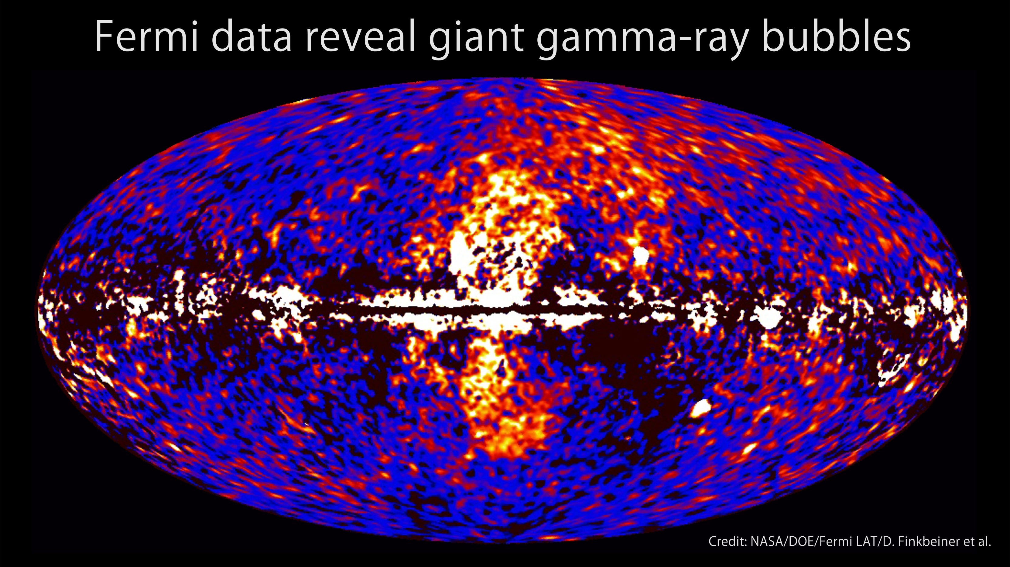
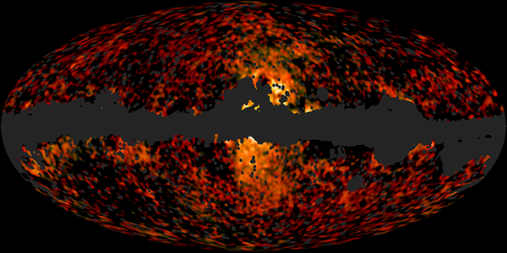
The Fermi Bubbles and Synchrotron Haze
In 2010, Su, Slatyer, and Finkbeiner discovered two giant bubble-like gamma ray features in the Fermi data, extending ~50° north and south of the Galactic Center
In 2012, the Planck collaboration reported that the synchrotron emission previously known as the “WMAP haze” is real, and is highly spatially correlated with the bubbles, supporting a common origin (inverse Compton/synchrotron from the same cosmic ray electron population)
Many questions remain: Powered by star formation? Past activity of central black hole? Another mechanism?

Slide 32
Annihilation Products in the Fermi Bubbles?
If dark matter annihilation products are responsible for the extended gamma-ray signal seen around the Galactic Center, then gamma-rays should also be discernable at higher Galactic Latitudes as well – this flux should be comparable in brightness to the Fermi Bubbles, for example
This provides an important test that can be used to discriminate between dark matter and pulsar interpretations of the extended Galactic Center signal (and also address the “the Galactic Center is too complicated” critique)
Is this high latitude emission present?
If so, can we see it?

Slide 33
Spectral Analysis of the Fermi Bubbles
We employ a template analysis to the Fermi data – the same approach as was previously used to discover the bubbles
Although we used three different sets of templates in our analysis (as a check of systematics), in this talk I will show results for our “diffuse model” template set:
  An isotropic template, or uniform offset (to absorb cosmic ray contamination)
  The Fermi diffuse model template (derived by the Fermi Collaboration using dust and gas maps to model pion emission and GALPROP to model inverse Compton emission; we use version P6V11, which was the last version that did not have include emission explicitly from the bubbles)
  Templates associated with the bubbles
For each energy energy bin, we vary the coefficients of each template to find the best-fit and the errors around those values
Hooper and Slatyer, arXiv:1302.6589

Slide 34
Spectral Analysis of the Fermi Bubbles
In previous template analyses of the bubbles, only one template was used for the bubbles (this essentially assumes that the spectrum from the bubbles does not vary much with latitude, longitude)
To see if the spectrum of the bubbles emission varies with Galactic Latitude, we break up the bubbles into five templates – if dark matter annihilation products are present, they should be prominent at low latitudes, and largely absent at high latitudes
Hooper and Slatyer, arXiv:1302.6589

Slide 35
Spectral Analysis of the Fermi Bubbles
Very strong spectral variation (with Galactic Latitude) is observed in the Fermi bubbles
Fairly flat at high latitudes, and much more peaked close to the Galactic Center
Hooper and Slatyer, arXiv:1302.6589

Slide 36
The Bubbles At High Latitudes
At high latitudes (|b|>30°), the observed gamma ray emission is very consistent with inverse Compton scattering of an power-law spectrum of electrons (dN_{e}/dE_{e} ~ E⁻³)
Hooper and Slatyer, arXiv:1302.6589

Slide 37
The Bubbles At High Latitudes
At high latitudes (|b|>30°), the observed gamma ray emission is very consistent with inverse Compton scattering of an power-law spectrum of electrons (dN_{e}/dE_{e} ~ E⁻³)
Furthermore, the same electrons can also easily account for the observed synchrotron haze (for B ~ 0.1-1 μG)
A very simple, plausible, and compelling explanation for both observations
Hooper and Slatyer, arXiv:1302.6589

Slide 38
The Bubbles At Low Latitudes
At low latitudes (|b|<20°), however, the observed emission is inconsistent with the inverse Compton scattering of any realistic spectrum of electrons
The best fits are found for electron spectra that are highly (unrealistically; basically a delta function) peaked near ~16 GeV
An additional spectral component is clearly present, concentrated at low galactic latitudes, and peaking at ~2-3 GeV
Hooper and Slatyer, arXiv:1302.6589

Slide 39
Annihilation Products in the Fermi Bubbles?
If we (not unreasonably) assume that the shape of the electron spectrum does not vary significantly throughout the volume of the bubbles, we can subtract the inverse Compton contribution from the observed spectrum
The residuals shown display a spectrum and morphology that is very similar to that observed from the Galactic Center region
The dotted lines are the predictions for a 10 GeV WIMP annihilating to τ⁺τ⁻, with an NFW-like profile of inner slope 1.2 (chosen to provide a good fit to the Galactic Center, see Hooper/Linden, Abazajian/Kaplinghat)
Hooper and Slatyer, arXiv:1302.6589

Slide 40
Annihilation Products in the Fermi Bubbles?
If we (not unreasonably) assume that the shape of the electron spectrum does not vary significantly throughout the volume of the bubbles, we can subtract the inverse Compton contribution from the observed spectrum
The residuals shown display a spectrum and morphology that is very similar to that observed from the Galactic Center region
The dotted lines are the predictions for a 10 GeV WIMP annihilating to τ⁺τ⁻, with an NFW-like profile of inner slope 1.2 (chosen to provide a good fit to the Galactic Center, see Hooper/Linden, Abazajian/Kaplinghat)
Key Point: The signal previously observed from the Galactic Center is not confined to the inner few hundred parsecs, but extends to at least ~3-4 kpc from the Inner Galaxy
Hooper and Slatyer, arXiv:1302.6589

Slide 41
Cross-Checks, Tests, and Questions
Our rather long paper (26 pages, including 20 figures and 5 appendices) includes many cross-checks and tests of our results; we are confident this signal is present, and that its spectrum and morphology are broadly similar to those described in our paper (although in some details we are less confident, such as in the spectrum from regions within ~5° the plane)
Although I direct you to our paper (or invite you to talk with me) if you are interested in other of these cross-checks, I’ll describe here some of the key tests we have performed
Hooper and Slatyer, arXiv:1302.6589

Slide 42
Cross-Checks, Tests, and Questions
Testing the quality of our template model
The main weakness of the template method is that it only produces reliable results when the templates collectively describe the data reasonably well
Because we are using crude, large scale templates, no sum of these templates should be expected to provide a formal fit to the Fermi data set that is “good”
Hooper and Slatyer, arXiv:1302.6589

Slide 43
Cross-Checks, Tests, and Questions
Testing the quality of our template model
The main weakness of the template method is that it only produces reliable results when the templates collectively describe the data reasonably well
Because we are using crude, large scale templates, no sum of these templates should be expected to provide a formal fit to the Fermi data set that is “good”
  In order for us to be confident that a signal identified using this technique is real, two criteria must be met:
  1) The quality of the fit must improve significantly when additional templates are added For example, when we replace the model with only one bubble template with a model with five bubble (latitude-divided) templates, the formal fit improves by 16σ
Hooper and Slatyer, arXiv:1302.6589

Slide 44
Cross-Checks, Tests, and Questions
Testing the quality of our template model
The main weakness of the template method is that it only produces reliable results when the templates collectively describe the data reasonably well
Because we are using crude, large scale templates, no sum of these templates should be expected to provide a formal fit to the Fermi data set that is “good”
  In order for us to be confident that a signal identified using this technique is real, two criteria must be met:
  1) The quality of the fit must improve significantly when additional templates are added For example, when we replace the model with only one bubble template with a model with five bubble (latitude-divided) templates, the formal fit improves by 16σ
  2) The residuals maps (data-model) must not be much larger than the magnitude of the signal being extracted
Hooper and Slatyer, arXiv:1302.6589

Slide 45
Residuals
1-10 GeV, longitude ±5° region
Hooper and Slatyer, arXiv:1302.6589

Slide 46
Residuals
1-10 GeV, longitude ±5° region
-With the exception of near the Galactic Plane (where the bubble templates vanish)residuals are small, a few percent of the total emission, fluctuating around zero
Total Emission
Residual (|data-model|)
Hooper and Slatyer, arXiv:1302.6589

Slide 47
Residuals
Residual+Bubbles
(data-model+bubbles)
1-10 GeV, longitude ±5° region
-With the exception of near the Galactic Plane (where the bubble templates vanish)residuals are small, a few percent of the total emission, fluctuating around zero
-The best fit bubbles emission is a factor of a few brighter than the residuals
Except for in the region near the Galactic Plane, our model can reliably extract the latitude-dependent spectrum of the bubbles
Total Emission
Residual (|data-model|)
Hooper and Slatyer, arXiv:1302.6589

Slide 48
Cross-Checks, Tests, and Questions
But Can We Find A Better Model?
So far, we have restricted our additional spectral component to the region of the bubbles – but if this is really from dark matter annihilation, it should be distributed with approximately spherical symmetry around the Galactic Center
Where the dark matter annihilations are brightest but outside of the bubbles, the disk is nearby -- perhaps difficult to discern from backgrounds?
But nonetheless, we can ask whether a NFW-like template might work better to extract this signal
Hooper and Slatyer, arXiv:1302.6589

Slide 49
Cross-Checks, Tests, and Questions
Model With 5 Bubble Templates and an NFW Template (γ = 1.2)
The question this exercise can answer is whether the GeV, bump-like signal gets absorbed mostly by the templates confined to the bubbles, or by the dark matter template
Hooper and Slatyer, arXiv:1302.6589

Slide 50
Cross-Checks, Tests, and Questions
Model With 5 Bubble Templates and an NFW Template (γ = 1.2)
The question this exercise can answer is whether the GeV, bump-like signal gets absorbed mostly by the templates confined to the bubbles, or by the dark matter template
We find that there is no discernable bump in the spectra of any of the bubbles templates; Instead, the GeV bump gets almost entirely absorbed by the dark matter template; this is especially clear when we mask within 5° of the plane, and take steps to limit the impact of emission associated with loop 1
Adding this template (chosen to match GC) improves the fit by 12σ
Hooper and Slatyer, arXiv:1302.6589

Slide 51
Three Common Perspectives, Circa 2012
The Dark Matter Enthusiast – These arguments look compelling; the extended GeV gamma ray excess from the Galactic Center probably comes from dark matter annihilations
The Pulsar Enthusiast – The signal is there and requires an explanation, but (millisecond) pulsars are at least as likely as dark matter
The Galactic Center Pessimist – The Galactic Center is so complicated from an astrophysical perspective that it would be almost impossible to identify a dark matter signal from that direction of the sky

Slide 52
Three Common Perspectives, Circa 2012
The Dark Matter Enthusiast – These arguments look compelling; the extended GeV gamma ray excess from the Galactic Center probably comes from dark matter annihilations
The Pulsar Enthusiast – The signal is there and requires an explanation, but (millisecond) pulsars are at least as likely as dark matter
The Galactic Center Pessimist – The Galactic Center is so complicated from an astrophysical perspective that it would be almost impossible to identify a dark matter signal from that direction of the sky
-We now know that this emission is not confined to the Galactic Center, but extends at least ~3-4 kpc, well beyond the extent that “Galactic Center Pessimist” type arguments might reasonably apply

Slide 53
Three Common Perspectives, Circa 2012
The Dark Matter Enthusiast – These arguments look compelling; the extended GeV gamma ray excess from the Galactic Center probably comes from dark matter annihilations
The Pulsar Enthusiast – The signal is there and requires an explanation, but (millisecond) pulsars are at least as likely as dark matter
The Galactic Center Pessimist – The Galactic Center is so complicated from an astrophysical perspective that it would be almost impossible to identify a dark matter signal from that direction of the sky
-We now know that this emission is not confined to the Galactic Center, but extends at least ~3-4 kpc, well beyond the extent that “Galactic Center Pessimist” type arguments might reasonably apply
-But what about pulsars?

Slide 54
Pulsars In The Fermi Bubbles?
There are two independent and compelling arguments against pulsars (millisecond and otherwise) as the source of this gamma ray emission:

Slide 55
Pulsars In The Fermi Bubbles?
There are two independent and compelling arguments against pulsars (millisecond and otherwise) as the source of this gamma ray emission:
1) The Spectrum – As in the case of the Galactic Center signal, the signal from the low-latitude regions of the bubbles exhibits a much harder spectrum than is observed from pulsars

Slide 56
Pulsars In The Fermi Bubbles?
There are two independent and compelling arguments against pulsars (millisecond and otherwise) as the source of this gamma ray emission:
1) The Spectrum – As in the case of the Galactic Center signal, the signal from the low-latitude regions of the bubbles exhibits a much harder spectrum than is observed from pulsars
2) The lack of pulsar-like point sources – To account for this signal, there must exist a significant population of unresolved MSPs well above/below the Galactic Plane; but Fermi does not see nearly enough point sources to account for this population
MSP population models which are consistent with the observed source distribution are capable of producing no more than ~1-10% of the observed excess emission

Slide 57
What kind of WIMP might these experiments be observing?
These gamma rays observed from the Galactic Center and the Inner Galaxy can be accommodated by a dark matter candidate with the following characteristics:
1) They must either
  A) Have a mass of ~10 GeV and annihilate to tau leptons (possibly along other leptons)
  B) Have a mass of ~40 GeV and annihilate to quarks
2) The total annihilation cross section (in the low velocity limit) to these primary final states must be very roughly ~3x10⁻²⁷ cm³/s (a factor of a few uncertainty exists from the normalization and shape of the the dark matter distribution)
3) The dark matter must be distributed in the Inner Galaxy roughly as ρ ~ r ^{-1.2}

Slide 58
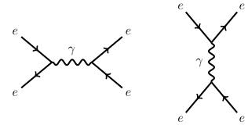
Three Simple Model Building Options
Focusing on the Leptonic (~10 GeV) case:
1) The WIMP could annihilate via t-channel exchange of lepton number carrying particles (like sleptons in SUSY)
2) Alternatively, the dark mater could annihilate through a new gauge boson with suppressed couplings to quarks; although given constraints from LEP, one is forced to consider a mediator that is either near resonance (m_{Z’} ~ 2 m_{X}) or that couples much more strongly to the dark matter than to electrons
3) Instead, the dark matter could also be part of a light hidden sector; ϕ’s decay to mesons, leptons through kinetic mixing with the photon – prompt pions lead to a gamma ray spectrum similar to that predicted from taus
X
τ⁻
X
τ⁺
X
τ⁻
Z’
X
τ⁺
X
ϕ
X
X
ϕ

Slide 59
Summary
In previous work (with Lisa Goodenough and Tim Linden), we had identified a component of gamma rays concentrated around the Galactic Center, with a spectrum peaked at GeV energies
The spectrum and morphology of the observed emission can be accounted for by annihilating dark matter distributed with a halo profile similar to those inferred from simulations (ρ α r ^{-γ}, γ~1.2-1.4), with a mass of 7-12 GeV (22-45 GeV), and an annihilation cross section to leptons (quarks) that is similar to that expected from a thermal relic
A population of ~10³ millisecond pulsars has also been suggested as a possible explanation for the signal from the Galactic Center
Tracy Slatyer and I have now identified gamma ray emission from well outside of the Galactic Center (extending to at least 3 kpc to the north and south) which shares the spectrum and morphology of the Galactic Center signal
Neither the spectrum nor the morphology of this signal is consistent with what is known about millisecond pulsars, or about any other astrophysical backgrounds

Slide 60
