Slide 1
Navigating Resting State Streams: Making Sure You’re Up the Creek with the Right Paddle
8/1/17
Hailey Dotterer & NeuroInitiative

Slide 2
Agenda
Brief Introduction to Resting State
Identifying Goals of Analyses
Proposed Steps Based on Goals
Analytic Approaches
DPABI Toolbox
Discussion is welcome and expected throughout!

Slide 3
Resting State
Form of functional neuroimaging
Uses BOLD signals to infer blood flow changes associated with differential neural activity
Focus on spontaneous brain activity without tasks (Fox & Raichle, 2007)
Sometimes referred to as “intrinsic”
Highly organized fluctuations correlated across the brain that are spatially structured
Correspond to regions typically co-activated in tasks (Smith et al., 2009)
Found to predict task activation & behavior (Fox et al., 2007)

Slide 4
Goals of Analyses
Ideal preprocessing streams vary according to goals of analyses

Slide 5
Goals of Analyses
Current Study
Sample of young adult men from longitudinal study of low-income families in Pittsburgh
MRI scans at age 22: task-related and resting functional connectivity, and structural connectivity (i.e., DTI)
Main interest in linking network abnormalities to antisocial behavior & psychopathic traits

Slide 6
Goals of Analyses
Key Interests
Potential abnormalities within networks (e.g., nodes within default mode network)
Short range connectivity
Potential abnormalities across networks (e.g., nodes in default mode network and nodes in salience network)
Distant connectivity
Relationships across neuroimaging modalities
Associations between structural and functional connectivity

Slide 7
fMRI Pre-Processing
Proposed Steps
Removal of first four (five, ten) volumes of each acquisition
Allow time for signal equilibration
Slice-timing correction
Corrects for the time of acquisition of each slice so that the time courses don’t seem different across slices
Interpolation to temporally align each slice to the start of each volume
Make sure to clarify the slice order
No difference found when order was ST→ RBR vs RBR →ST Parkes et al., 2017
Two-pass rigid body realignment
Assigns correct signals to each voxel after motion
All volumes to first volume → All volumes to mean volume
Can provide measure of displacement of head from a fixed position at every TP in the scan
6 motion parameters (MP)
Notes:
-Why four vs different number of volumes removed?
Two-pass: get the benefit of the first volume (directly after anatomical scan or in general minimal movement since early in the scan) and also using an average volume (contains more volume and all volumes are more or less similarly different to it- but could be built from unaligned volumes)
Rigid body= each image can be moved but not distorted to best align with all the other images

Slide 8
fMRI Pre-Processing
Proposed Steps
Co-registration
Align functional images with structural image
Use high-resolution structural image
Normalization
Individual subject-space into reference-space to facilitate group-level comparisons
MNI template common, but can use other templates
Some arguments for working in native space (see Magalhães et al., 2015)

Slide 9
Additional Considerations: Noise
Proposed Steps
Can be related to scanner, non-neuronal physiological processes, or motion
Measures of motion:
Absolute displacement of head
Relative displacement of head (i.e., framewise displacement; FD)
Movement from one volume to the next
Various measures calculated differently
Van Dijk et al 2012; Power et al., 2012; Jenkinson et al., 2002
Target similar properties, often highly correlated
Keep in mind realignment estimates not entirely accurate
Power et al., 2015
Notes:
Van Dijk: Root mean square derivs of the translational realignment
Power: summed absolute values of the derivs of the translational and rotational realignment estimates (after converting rotational estimates to displacement at 50 mm)
Jenksinon: root mean squared volume to volume displacement of all voxels measured from 6 head motion parameters; threshold if FD > .25 mm
-FD(Power) has values almost twice of FD(Jenk), and FD(Jenk) has almost twice of FD(VanDijk)
-also depends on TR- determines how rapidly movements will be sampled and subdivided

Slide 10
Effects of Motion
Proposed Steps
Three types of spurious motion variance:
Increase in signal correlation between nearby voxels
When similar disruption occurs between voxels
Prominent
Increase in signal correlation between distant voxels
If signal disruption widespread and similar across brain
Prominent
Correlations go to zero or become negative
Dissimilar disruptions, such as motion affecting only one of the voxels
Typically occurs between distant voxels
Less prominent
Typically without denoising:
Correlations at all distances are elevated by motion
Correlations at short distances are more elevation than those at longer distances
Power et al., 2015

Slide 11
De-Noising Options
Proposed Steps
High-parameter confound strategies
Expand realignment parameters or tissue-compartment signals (Yan, Cheung et al., 2013a)
e.g., include derivative or squares of original and derivative regressors
Regression of mean WM & CSF
Average time series from all WM or CSF voxels
Principal component analysis (PCA)
i.e., CompCor (Muschelli et al., 2014)
Directions of variation based on anatomy or temporal variance (aCompCor or tCompCor)
Orthogonal components instead of averaged signal
Whole-brain independent component analysis (ICA)
Single-subject time series
Noise components chosen with classifier (ICA-FIX; Griffanti et al., 2014) or a priori heuristics (ICA-AROMA; Pruim et al., 2015)
Temporal censoring
Identify & remove or de-weight volumes with artifact, can be followed by interpolation
Scrubbing (Power et al., 2015); Spike regression (Satterthwaite et al., 2013); De-spiking (Patel et al., 2014)
Global signal regression
Regressing voxel-wise signal against mean signal averaged across brain (Power et al., 2015)
Notes:
High parameter: use from realignment
-translational axes x, y, z and rotational axes of pitch, roll, yaw are the basics; can also include temporal derivatives of each parameter (first-order backwards differences in head motion= 12 P) or these plus squares of both original and derivative time series (24)
CompCor: BOLD time series from voxels presumed to sample non-neuronal physio are summarized as temporal principal components and entered as nuisance parameters in linear regression
anatomical: noise related PC from WM and CSF voxel time course
-can do 5 leading PCs for each tissue (typical) or number that explains at least 50% of variance for each tissue- so amount would depend on subject; the latter has outperformed the former but also could cost a lot of tdOf
-automated selection of noise-related from spatial ICA
-Fix: select based on matches to a manually curated training set of noise components
-AROMA: no straining set, automatic detection according to set of a priori criteria
Scrubbing: removing volumes for which FD exceeds pre-determined threshold;
Adjacent volumes also optionally removed since large FDs can affect BOLD signal in later TP
Spike regression: modeling influence of contaminated TP using separate delta functions, one for each contaminated TP, and removing effects via a linear regression
Despiking: Unsupervised method detects non-stationary events, caused by movement, as chains of scale invariant maximal or minimal wavelet coefficients, and despikes these from voxel time series; decomposes voxel signals into wavelet space, identifies trains of “bad” high-amplitude wavelets that likely reflect motion artifact, and reconstitutes denoised voxel signals from the “good” wavelets *not clear if motion artifacts are fully removed
For use in censoring:
Van Dijk: Root mean square derivs of the translational realignment
In scrubbing typically use:
Power: summed absolute values of the derivs of the translational and rotational realignment estimates (after converting rotational estimates to displacement at 50 mm); threshold is > .2; contaminated volumes removed
In Spike Regression typically use:
Jenksinon: root mean squared volume to volume displacement of all voxels measured from 6 head motion parameters; threshold if FD > .25 mm; separate nuisance regressor generated that matches the length of BOLD time series, with value of ‘1’ at location of contaminated volume and ‘0’ elsewhere; volumes thus differ for participants

Slide 12
Quality Control
Proposed Steps
QC-FC correlations
Correlation between FD and FC at each pair of regions
QC-FC distance dependence
Dependence of QC-FC correlations on distance between brain regions
Motion-BOLD contrasts
SPM of association between FD and voxel-wise BOLD time course
High-motion vs low-motion contrasts
Mean differences in FC between high versus low motion subgroups
FD-DVARs correlations
Correlation between motion and change in signal intensity from one volume to the next (DVARS; temporal derivative of root mean square variance over voxels, calculated at every TP)
tDOF-loss
Loss in temporal degrees of freedom due to noise correction (number of nuisance regressors input to the GLM used to model noise)
Test-retest reliability (TRT)
If you have longitudinal data ☺; intra-class correlation coefficients
Parkes et al., 2017
Notes:
QC-FC values are higher for regional pairs separated by short distances- Pearson’s between subject specific FD (however you measured it) and FC estimates for each edge= edge specific QC-FC across entire sample; see if statistically significant at p< .05 FDR corrected
QC-FC distance dependence: estimate distance between regions (can do Euclidean distance between stereotaxic coordinates of the volumetric centers of brain region pairs); for each edge, quantify association between this distance and QC-FC with Spearman’s rank correlation coeff (non-linearity sometimes occurs); then plot the correlations of each edge as function of distance metric
Motion-BOLD contrast: identifies regions showing sig motion contamination
*high motion vs low motion contrasts (HLM): mean diff in FC b/ween HC split into high and low motion sub groups
No single approach has performed best; in general models that include expansion do better –on HLM and motion-bold, but reduced TRT
-that include 6 HMP and mean wm/CSF
-adding volume censoring improve qc fc, distance depend, hlm contrasts and motion bold
-gsr leads to improved motion bold and qc-fc but exaggerates distance dependence
-expanding motion reg with acompcor reduced fd-dvars without gsr or scrubbing
-ica aroma same as expanded motion reg with scrubbing, better than expanded motion with acompcor on hlm while reducing tdof loss
-ica aroma and acompcor less at qc fc but had almost no qc fc distance dependence
-generally trade off between modelling contributions of noise and limiting number of noise regressors to avoid overfitting and/or severe tDOF-loss

Slide 13
Limitations of Methods
High-parameter confound strategies
Rely on accurate realignment algorithms
Regression-based only model linear motion-induced variation, dynamics are non-linear
Large set of nuisance regressors-> overfitting of data, removal of signal of interest
Principal component analysis (PCA)
Does not sufficiently correct for motion
Whole-brain independent component analysis (ICA)
Labeling done by hand= time-consuming
Labeling by classifier= may require re-training, classifiers could be biased to training set
Temporal censoring
Shorten time series, loss of temporal degrees of freedom
tDoF determines estimation of accuracy of subject-level stats
Removing volumes destroys autocorrelation structure, impacts frequency filtering, prevents examination of frequency characteristics or non-stationarity
If interpolating data, must consider qualities of the interpolated TP and how to treat synthetic data compared to real data
Global signal regression
Potential removal of important signal, introduces anti-correlations
Biases group differences
Increases distance-dependent artifact (i.e., increased connectivity in short-range connections, reduced in long-range)

Slide 14
Functional Connectivity Processing
Proposed Steps
Exclusion of high-motion participants
mFD(Jenkinson) > .55 & number of volumes with FD(Jenkinson) < .25 results in <4 minutes of data (Parkes et al., 2017)
Spatial smoothing
6 or 8 mm typical
Specifically at this stage due to decision to use ICA-AROMA
Segmentation of structural image
Include average time series from WM & CSF as regressors
ICA-AROMA
Performs best on reducing distance dependence
Performs fairly well on other benchmarks
ICA that doesn’t require training set
Bandpass filtering between .008-.08 HZ
Typically correct for low-frequency drifts in data caused by non-experimental effects (high-pass)
Resting-state networks often referred to as ‘low frequency’
Recent evidence that intrinsic fluctuations more broadband, up to .8 (Chen & Glover, 2015)
Bandpass filtering important for addressing motion-related variability (Bright et al., 2017; Hallquist et al., 2013)
Notes:
Exclusion of high-motion participants is the only step here that is somewhat controversial, but it should be done early on (if you’re going to do it), to avoid them impacting everyone else
-Choose your threshold based on the FD calculation you use and previous literature; in my case, there’s no reason to suspect that high motion would be highly correlated except in the case of perhaps subjects with ADHD symptoms- in that case I can see if participants excluded had sig higher levels of ADHD and in that case would re-evaluate
-Parkes et al 2017 found
-In other cases smoothing would generally come after noise correction

Slide 15
What Now?
Analytic Approaches
Back to goals of analyses!

Slide 16
Analytic Approaches
Interest in :
Depicting local features of BOLD signal?
Regional Homogeneity (ReHo) (Zang et al., 2004)
Calculate the Kendall coefficient of concordance
Similarity or synchronization of time courses within a cluster (i.e., neighboring voxels)
Amplitude of Low Frequency Fluctuation (ALFF) (Biswal et al., 1995; Zang et al., 2007)
Magnitude of the fluctuation of the voxels within clusters
Fractional ALFF (fALFF)= inclusion of information in frequencies outside of the normal range (Zou et al., 2008)
Used to localize abnormal spontaneous brain activity in different disorders (i.e., ADHD, schizophrenia)

Slide 17
Analytic Approaches
Interest in :
Measuring functional relationships between regions?
Non-model-driven methods
ICA: decomposes data into independent components with principal components analysis (within participants)
Spatial ICA= components are maximally spatially independent (but there can be spatial overlap), time courses must not be highly co-linear
Temporal ICA= components are orthogonal time courses, spatial independence not required
Group ICA: Starts with group-level ICA, then generates subject-specific versions (Calhoun et al., 2001)
Tools
Group ICA of fMRI ToolBox; GIFT (see Links)
Multivariate Exploratory Linear Optimized Decomposition into Independent Components; MELODIC (Beckman et al., 2004)
MATLAB Toolbox for Functional Connectivity (Zhou et al., 2009)
Functional Connectivity Toolbox (see Links)

Slide 18
Analytic Approaches
Interest in :
Measuring functional relationships between regions?
Model-driven methods (generally use ROIs)
Seed-based correlation analysis (SCA) (e.g., Biswal et al., 1995)
Whole-brain, voxel-wise functional connectivity maps of covariance with the seed region
Structural equation modeling
Doesn’t take into account features of fMRI (e.g., temporal variations in connections)
Granger causality (Roebreck et al., 2005; Sridharan et al., 2008)
Bayesian network (BN) modeling approaches (e.g., Li et al., 2008)
Dynamic causal modeling (DCM) (Friston et al., 2014)
Group Iterative Multiple Model Estimation (GIMME) (Beltz & Molenaar 2016; Gates & Molenaar, 2012)
If interested in effective connectivity, recommend reading Cole et al., 2010 & Ramsey et al., 2010
Be mindful of you select ROIs
Surface-based parcellations, atlases, subject-specific maps, coordinates from previous work

Slide 19
Analytic Approaches
Interest in :
Examining relationships across modalities?
Analyses with extracted values (e.g., SEM)
Joint ICA (Calhoun et al., 2009)
Extracts maximally spatially independent maps for each modality that are coupled together by a shared loading parameter

Slide 20
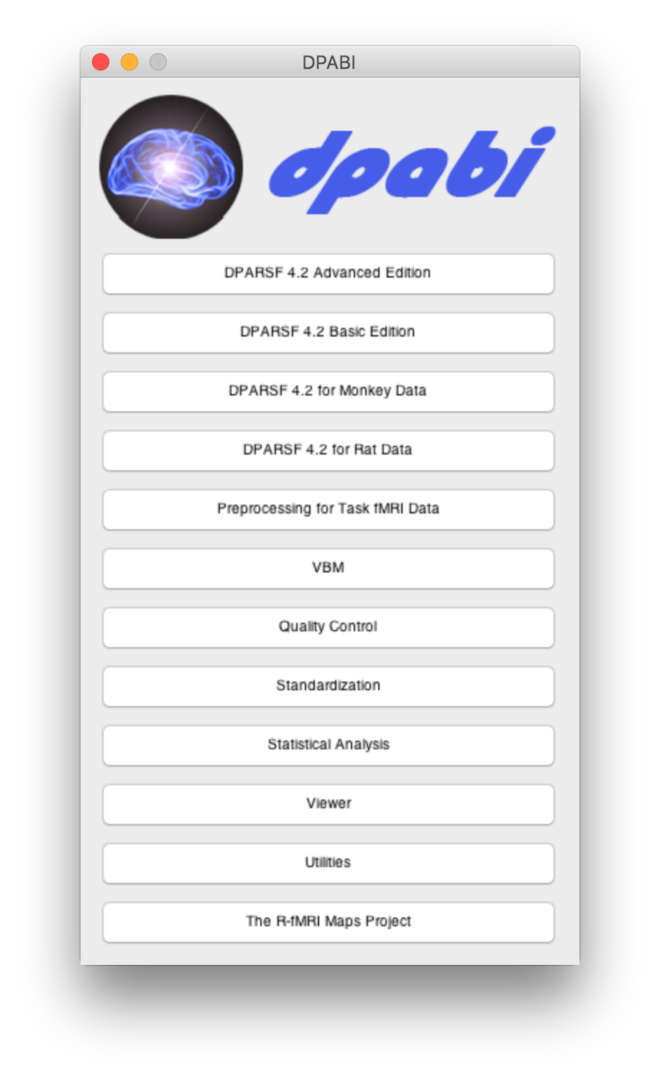
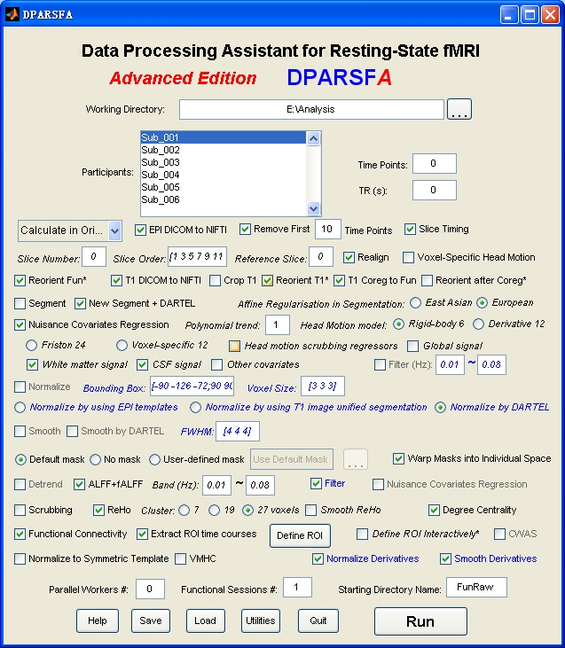
Suggested Toolbox: DPABI
Data Processing Assistant for Resting-State fMRI
Based on Matlab, SPM, REST, MRIcroN’s dcm2nii
Many options described above included
Free and available online

Slide 21
Full Pre-Processing Pipeline:
Removal of first four volumes
Slice-timing correction
Two-pass rigid body realignment
Co-registration
Normalization to MNI space
Inspection of processed EPI data (Determination of participants to exclude)
Removal of participants with high proportion of motion based on spike regression parameters
Smoothing with 6 mm kernel
ICA-AROMA + WM & CSF nuisance regressors
WM & CSF from segmentation of T1 weighted images from group-specific template using DARTEL
Binarized tissue masks for each after thresholding tissue probability maps
If comparing groups, include tDOF-loss as covariate
Review Quality Control
Report QC-FC correlations, QC-FC distance dependence, Group differences in FC between high versus low motion participants
Notes:
ICA-AROMA motion-related criteria: (1) more than 10% of IC voxels were located within CSF; (2) IC time series contained more than 35% high-frequency content, where high-frequency is defined as a fraction of the Nyquist frequency at which higher frequencies explain 50% of the total power between 0.01 Hz and the Nyquist frequency; and (3) ICs exceed a decision boundary from a two-dimensional linear discriminant analysis (LDA) classifier. For the classifier, a two-dimensional feature space was defined using (1) the proportion of IC voxels that overlapped the edges of the brain; and (2) the maximum absolute correlation between the IC time series and parameters in an expanded head motion model, which included 72 motion realignment parameters comprising the same as those in our 24HMP model plus 24 parameters from a single time-point back and forward. Pruim then defined a hyperplane using an LDA classifier trained on manually labelled ICs (labelled as either ‘Motion’, ‘Resting State Network’, or ‘Other’) from 30 rs-fMRI datasets.

Slide 22
Links
GIFT: http://icatb.sourceforge.net/groupica.htm
Functional Connectivity Toolbox: http://web.mit.edu/swg/software.htm
MELODIC: https://fsl.fmrib.ox.ac.uk/fsl/fslwiki
ICA-AROMA: https://fsl.fmrib.ox.ac.uk/fsl/fslwiki/OtherSoftware
J-ICA: http://mialab.mrn.org/software/fit/
DPABI: http://rfmri.org/dpabi
Graphical Causal Models: http://www.phil.cmu.edu/projects/tetrad/

Slide 23
References
Beckmann C. F., Smith S. M. (2004). Probabilistic independent component analysis for functional magnetic resonance imaging. IEEE Trans. Med. Imaging 23, 137–15210.1109/TMI.2003.822821
Beltz, A. M., & Molenaar, P. C. (2016). Dealing with multiple solutions in structural vector autoregressive models. Multivariate behavioral research, 51(2-3), 357-373.
Biswal B., Yetkin F. Z., Haughton V. M., Hyde J. S. (1995). Functional connectivity in the motor cortex of resting human brain using echo-planar MRI. Magn. Reson. Med. 34, 537–54110.1002/mrm.1910340409
Calhoun V. D., Adali T., Pearlson G. D., Pekar J. J. (2001). A method for making group inferences from functional MRI data using independent component analysis. Hum. Brain Mapp. 14, 140–15110.1002/hbm.1048
Calhoun, V. D., Liu, J., & Adalı, T. (2009). A review of group ICA for fMRI data and ICA for joint inference of imaging, genetic, and ERP data. Neuroimage, 45(1), S163-S172.
Chen, J. E., & Glover, G. H. (2015). BOLD fractional contribution to resting-state functional connectivity above 0.1 Hz. NeuroImage, 107, 207-218.
Cole, D. M., Smith, S. M., & Beckmann, C. F. (2010). Advances and pitfalls in the analysis and interpretation of resting-state FMRI data. Frontiers in systems neuroscience, 4.
Fox, M.D., Raichle, M.E., 2007. Spontaneous fluctuations in brain activity observed with functional magnetic resonance imaging. Nat Rev Neurosci 8, 700–711. doi:10.1038/nrn2201
Fox, M.D., Snyder, A.Z., Vincent, J.L., Raichle, M.E., 2007. Intrinsic Fluctuations within Cortical Systems Account for Intertrial Variability in Human Behavior. Neuron 56, 171– 184. doi:10.1016/j.neuron.2007.08.023
Friston, K. J., Kahan, J., Biswal, B., & Razi, A. (2014). A DCM for resting state fMRI. Neuroimage, 94, 396-407.
Gates, K. M., & Molenaar, P. C. (2012). Group search algorithm recovers effective connectivity maps for individuals in homogeneous and heterogeneous samples. Neuroimage, 63(1), 310-319.
Griffanti, L., Salimi-Khorshidi, G., Beckmann, C.F., Auerbach, E.J., Douaud, G., Sexton, C.E., Zsoldos, E., Ebmeier, K.P., Filippini, N., Mackay, C.E., Moeller, S., Xu, J., Yacoub, E., Baselli, G., Ugurbil, K., Miller, K.L., Smith, S.M., 2014. ICA-based artefact removal and accelerated fMRI acquisition for improved resting state network imaging. NeuroImage 95, 232–247. doi:10.1016/j.neuroimage.2014.03.034
Hallquist, M. N., Hwang, K., & Luna, B. (2013). The nuisance of nuisance regression: spectral misspecification in a common approach to resting-state fMRI preprocessing reintroduces noise and obscures functional connectivity. Neuroimage, 82, 208-225.
Jenkinson, M., Bannister, P., Brady, M., Smith, S., 2002. Improved Optimization for the Robust and Accurate Linear Registration and Motion Correction of Brain Images. NeuroImage 17, 825–841. doi:10.1006/nimg.2002.1132

Slide 24
References
Li, J., Wang, Z. J., Palmer, S. J., & McKeown, M. J. (2008). Dynamic Bayesian network modeling of fMRI: a comparison of group-analysis methods. Neuroimage, 41(2), 398-407.
Magalhães, R., Marques, P., Soares, J., Alves, V., & Sousa, N. (2015). The impact of normalization and segmentation on resting-state brain networks. Brain connectivity, 5(3), 166-176.
Patel, A.X., Kundu, P., Rubinov, M., Jones, P.S., Vértes, P.E., Ersche, K.D., Suckling, J., Bullmore, E.T., 2014. A wavelet method for modeling and despiking motion artifacts from resting-state fMRI time series. NeuroImage 95, 287–304. doi:10.1016/j.neuroimage.2014.03.012
Power, J.D., Barnes, K.A., Snyder, A.Z., Schlaggar, B.L., Petersen, S.E., 2012. Spurious but systematic correlations in functional connectivity MRI networks arise from subject motion. NeuroImage 59, 2142–2154. doi:10.1016/j.neuroimage.2011.10.018
Power, J.D., Schlaggar, B.L., Petersen, S.E., 2015. Recent progress and outstanding issues in motion correction in resting state fMRI. NeuroImage 105, 536–551. doi:10.1016/j.neuroimage.2014.10.044
Pruim, R.H.R., Mennes, M., Buitelaar, J.K., Beckmann, C.F., 2015a. Evaluation of ICAAROMA and alternative strategies for motion artifact removal in resting state fMRI. NeuroImage 112, 278–287. doi:10.1016/j.neuroimage.2015.02.063
Pruim, R.H.R., Mennes, M., van Rooij, D., Llera, A., Buitelaar, J.K., Beckmann, C.F., 2015b. ICA-AROMA: A robust ICA-based strategy for removing motion artifacts from fMRI data. NeuroImage 112, 267–277. doi:10.1016/j.neuroimage.2015.02.064
Ramsey J. D., Hanson S. J., Hanson C., Halchenko Y. O., Poldrack R. A., Glymour C. (2010). Six problems for causal inference from fMRI. Neuroimage 49, 1545–155810.1016/j.neuroimage.2009.08.065
Roebroeck A., Formisano E., Goebel R. (2005). Mapping directed influence over the brain using Granger causality and fMRI. Neuroimage 25, 230–24210.1016/j.neuroimage.2004.11.017

Slide 25
References
Smith, S.M., Fox, P.T., Miller, K.L., Glahn, D.C., Fox, P.M., Mackay, C.E., Filippini, N., Watkins, K.E., Toro, R., Laird, A.R., Beckmann, C.F., 2009. Correspondence of the brain's functional architecture during activation and rest. Proceedings of the National Academy of Sciences 106, 13040–13045. doi:10.1073/pnas.0905267106
Sridharan, D., Levitin, D. J., & Menon, V. (2008). A critical role for the right fronto-insular cortex in switching between central-executive and default-mode networks. Proceedings of the National Academy of Sciences, 105(34), 12569-12574.
Van Dijk, K.R.A., Sabuncu, M.R., Buckner, R.L., 2012. The influence of head motion on intrinsic functional connectivity MRI. NeuroImage 59, 431–438. doi:10.1016/j.neuroimage.2011.07.044
Yan, C.-G., Cheung, B., Kelly, C., Colcombe, S., Craddock, R.C., Di Martino, A., Li, Q., Zuo, X.-N., Castellanos, F.X., Milham, M.P., 2013a. A comprehensive assessment of regional variation in the impact of head micromovements on functional connectomics. NeuroImage 76, 183–201. doi:10.1016/j.neuroimage.2013.03.004
Yan, C.-G., Craddock, R.C., Milham, M.P., He, Y., 2013b. Addressing head motion dependencies for small-world topologies in functional connectomics 1–19. doi:10.3389/fnhum.2013.00910/abstract
Yan, C. G., Wang, X. D., Zuo, X. N., & Zang, Y. F. (2016). DPABI: data processing & analysis for (resting-state) brain imaging. Neuroinformatics, 14(3), 339-351.
Zang Y, Jiang T, Lu Y, He Y, Tian L (2004) Regional homogeneity approach to fMRI data analysis. Neuroimage 22: 394–400.Y. ZangT. JiangY. LuY. HeL. Tian2004Regional homogeneity approach to fMRI data analysis.Neuroimage22394400
Zang Y. F., He Y., Zhu C. Z., Cao Q. J., Sui M. Q., Liang M., Tian L. X., Jiang T. Z., Wang Y. F. (2007). Altered baseline brain activity in children with ADHD revealed by resting-state functional MRI. Brain Dev. 29, 83–9110.1016/j.braindev.2006.07.002
Zou Q. H., Zhu C. Z., Yang Y., Zuo X. N., Long X. Y., Cao Q. J., Wang Y. F., Zang Y. F. (2008). An improved approach to detection of amplitude of low-frequency fluctuation (ALFF) for resting-state MRI: fractional ALFF. J. Neurosci. Methods 172, 137–14110.1016/j.jneumeth.2008.04.012

Slide 26
Reviews of Streams
Ciric, R., Wolf, D.H., Power, J.D., Roalf, D.R., Baum, G., Ruparel, K., Shinohara, R.T., Elliott, M.A., Eickhoff, S.B., Davatzikos, C., Gur, R.C., Gur, R.E., Bassett, D.S., Satterthwaite, T.D., 2017. Benchmarking of participant-level confound regression strategies for the control of motion artifact in studies of functional connectivity. NeuroImage 1–22. doi:10.1016/j.neuroimage.2017.03.020
Bright, M. G., Tench, C. R., & Murphy, K. (2017). Potential pitfalls when denoising resting state fMRI data using nuisance regression. NeuroImage, 154, 159-168.
Excellent review of outstanding issues in general
Burgess, G. C., Kandala, S., Nolan, D., Laumann, T. O., Power, J. D., Adeyemo, B., ... & Barch, D. M. (2016). Evaluation of denoising strategies to address motion-correlated artifacts in resting-state functional magnetic resonance imaging data from the human connectome project. Brain connectivity, 6(9), 669-680.
Gargouri, F., Delphine, S., Lehéricy, S., & Hamida, A. B. (2016, March). The influence of preprocessing steps on functional connectivity in resting state fMRI. In Advanced Technologies for Signal and Image Processing (ATSIP), 2016 2nd International Conference on (pp. 103-107). IEEE.
Parkes, L., Fulcher, B. D., Yucel, M., & Fornito, A. (2017). An evaluation of the efficacy, reliability, and sensitivity of motion correction strategies for resting-state functional MRI. bioRxiv, 156380.
Pruim, R.H.R., Mennes, M., Buitelaar, J.K., Beckmann, C.F., 2015a. Evaluation of ICAAROMA and alternative strategies for motion artifact removal in resting state fMRI. NeuroImage 112, 278–287. doi:10.1016/j.neuroimage.2015.02.063
Pruim, R.H.R., Mennes, M., van Rooij, D., Llera, A., Buitelaar, J.K., Beckmann, C.F., 2015b. ICA-AROMA: A robust ICA-based strategy for removing motion artifacts from fMRI data. NeuroImage 112, 267–277. doi:10.1016/j.neuroimage.2015.02.064
Varikuti, D. P., Hoffstaedter, F., Genon, S., Schwender, H., Reid, A. T., & Eickhoff, S. B. (2017). Resting-state test–retest reliability of a priori defined canonical networks over different preprocessing steps. Brain Structure and Function, 222(3), 1447-1468.
Vergara, V. M., Mayer, A. R., Damaraju, E., Hutchison, K., & Calhoun, V. D. (2017). The effect of preprocessing pipelines in subject classification and detection of abnormal resting state functional network connectivity using group ICA. Neuroimage, 145, 365-376.
Yan, C.-G., Craddock, R.C., Milham, M.P., He, Y., 2013. Addressing head motion dependencies for small-world topologies in functional connectomics 1–19. doi:10.3389/fnhum.2013.00910/abstract

