Slide 1
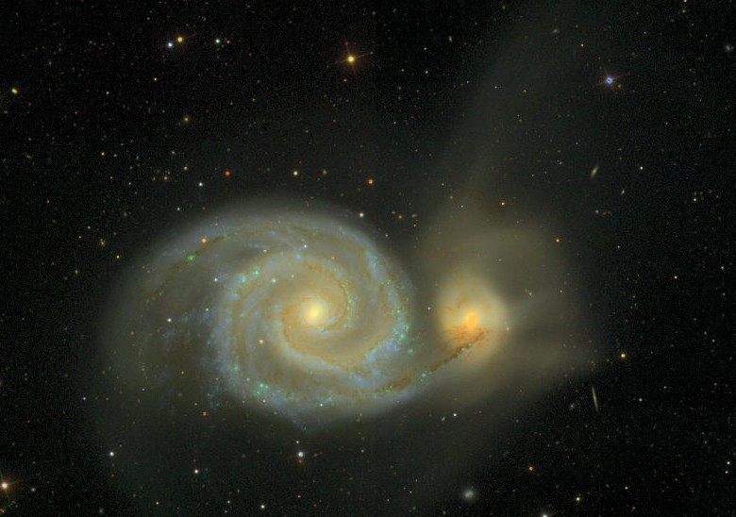
Universal access to the sky: amateurs, professionals, and the virtual observatory
Tim McKay
Low Brow Astronomers 12/18/09

Slide 2
Our plan for tonight
A short presentation on the roles of the amateur and the professional…
Some comments on interesting amateur/professional collaborations, the Christmas count and “GalaxyZoo”
A few interesting examples of how online data can impact the experience of the sky for everyone.
Questions, comments, and discussion…

Slide 3
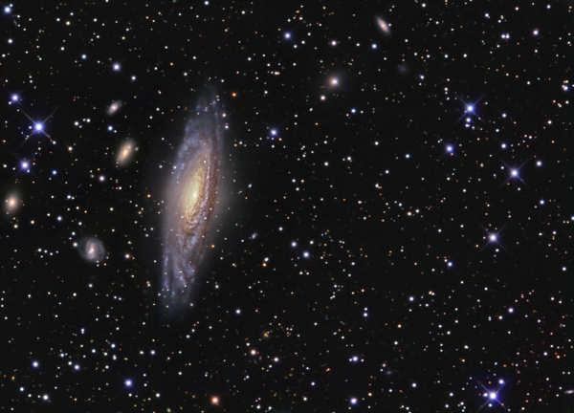
Astronomy is seductive
The night sky has always attracted attention from people everywhere
It’s free to all, studied and enjoyed by millions for its own sake
The ‘amateur’ community plays an important role in astronomy on many levels…

Slide 4
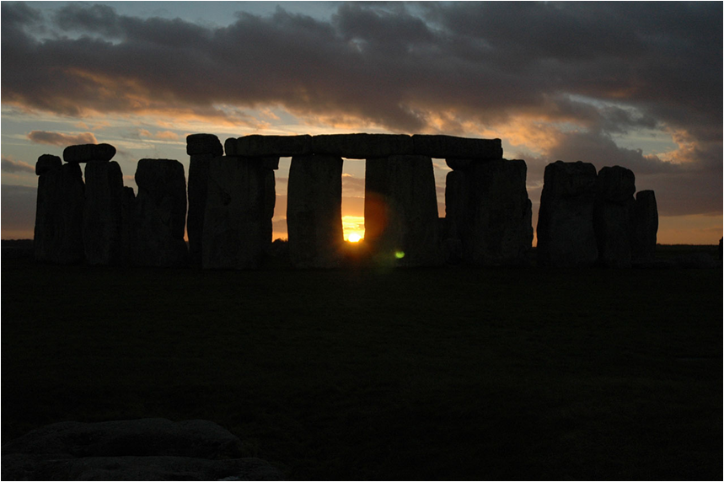
Amateur and Professional “scientists”
All science was originally done by amateurs
Professionalization, and even naming, took place only in the late 19th century
William Whewell, 1840, Philosophy of the Inductive Sciences I. “We need very much a name to describe a cultivator of science in general. I should incline to call him a Scientist.”

Slide 5
Everyone loves science…
Many other areas of science are enjoyed and practiced seriously by a wide array of people
Most focus on the natural world, largely on human scales:
Birding
Mountain climbing
Fossil hunting
Gardening
We all participate in various ways. My own activities divide into two classes:
Personal science: what I do for myself and with others to understand and appreciate the world
Public science: what I get paid for. I do this for myself too, but it must be worth being paid for.
Teaching helps me to bridge these…

Slide 6
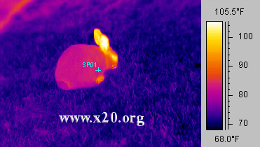
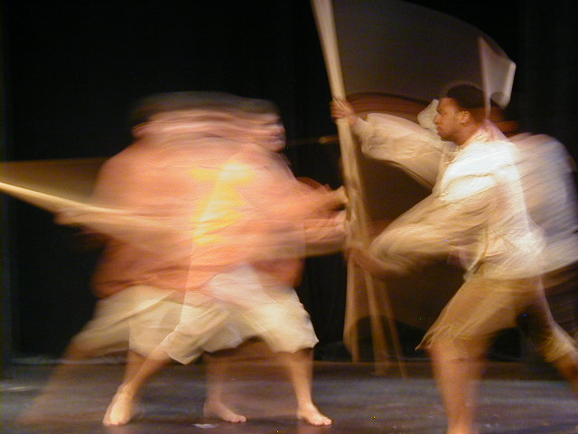
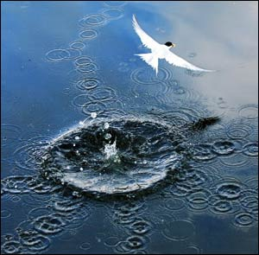
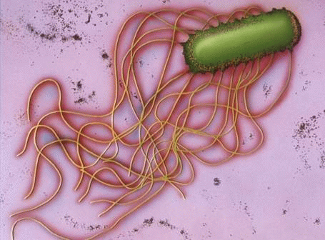
Physics for the Life Sciences I: Fall 2008
Racquetball Striking a Wall
Lecture #1
September 3, 2008
Tim McKay
Stewart Hall
Mt. Etna

Slide 7
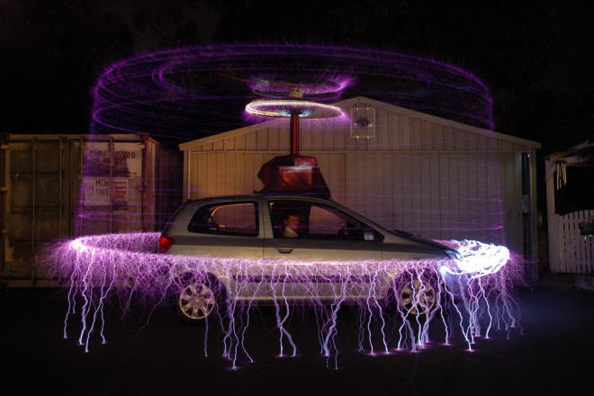
How should we value these?
Amateurs have ultimate freedom, but limited resources
Their pursuits are driven by personal interest and taste, rather than authority and fashion
Amateurs are free to keep what they learn to themselves
The professional must focus tightly to be effective, but has extensive resources
Their pursuits are often influenced by external priorities, especially funding
They must always communicate what they learn with the world

Slide 8
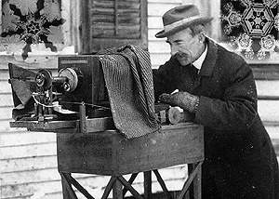
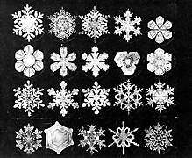
When amateurs make important contributions to “professional” science, they do it through unremunerated professional levels of focus

Slide 9
Two examples of important amateur/professional collaborations
The Audubon Society’s “Christmas Bird Count”
http://www.audubon.org/Bird/cbc/
In 1900, 27 people counted 18,500 birds
In 2008, 59,918 people counted in 2113 circles, and found 57,704,250 birds!
This provides irreplaceable long term population monitoring
The GalaxyZoo project
http://www.galaxyzoo.org/
Galaxy images from the Sloan Digital Sky Survey examined in detail by more than 150,000 individuals
More than 50 million classifications done
Important new details learned, and a tricky bias uncovered

Slide 10
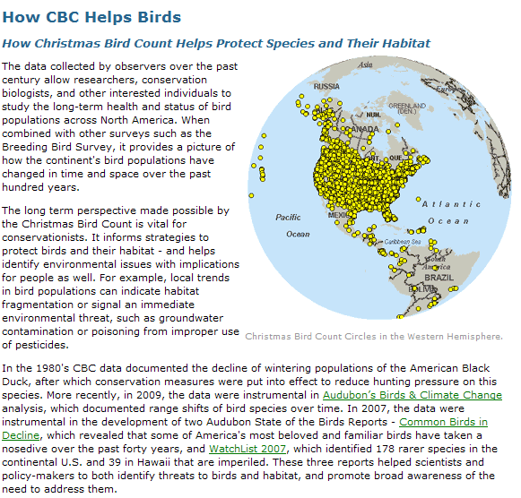

Slide 11
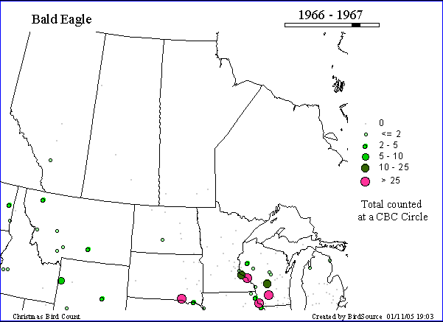
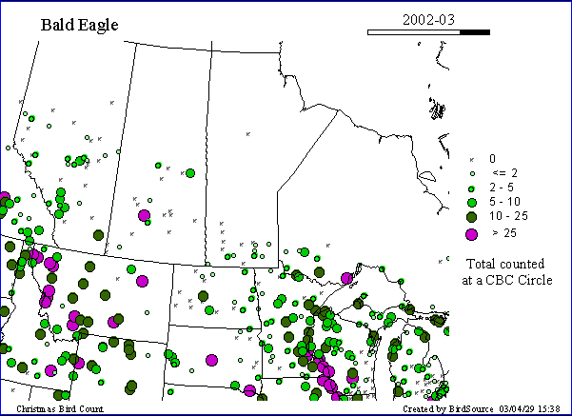
Bald Eagles: population changes since I was a kid…

Slide 12
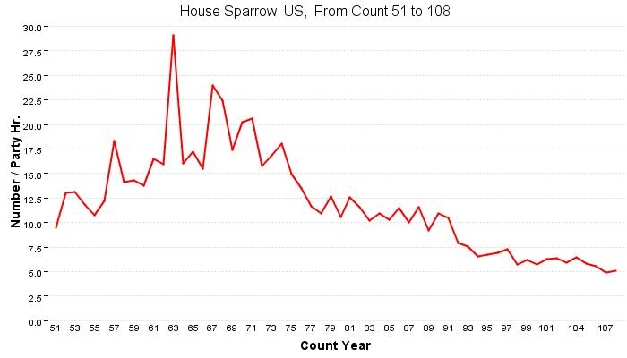

Slide 13
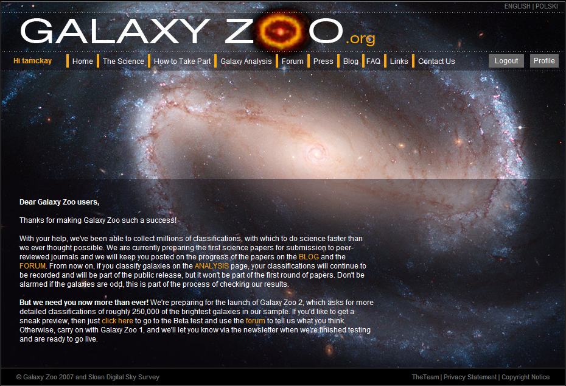

Slide 14
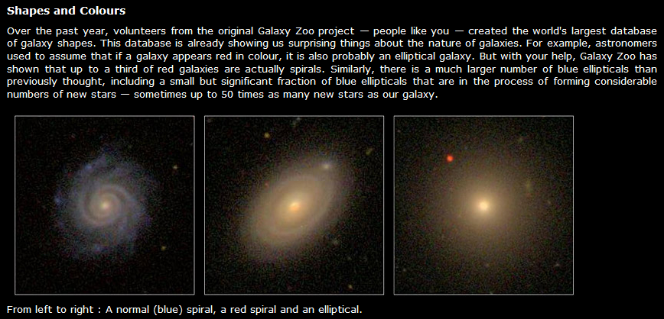

Slide 15
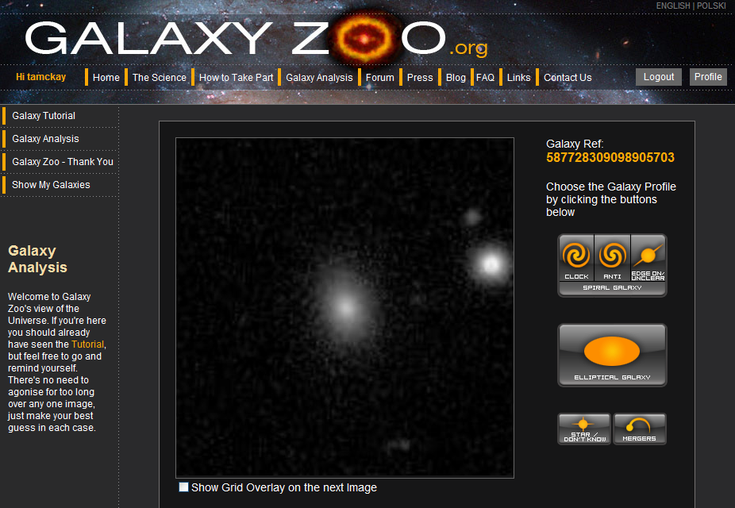

Slide 17
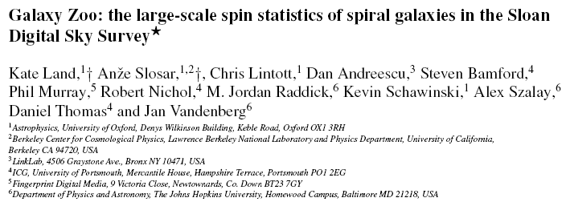
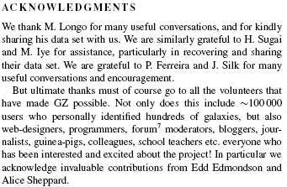

Slide 18
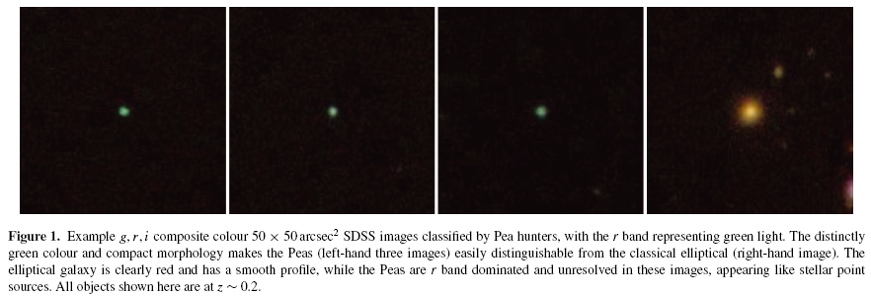
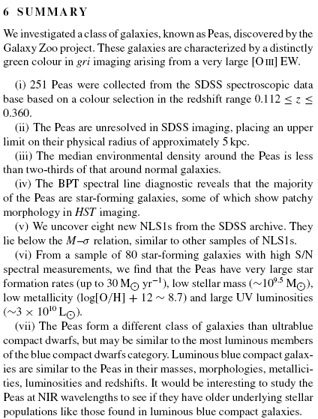
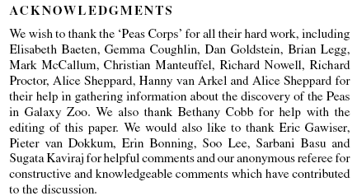

Slide 19
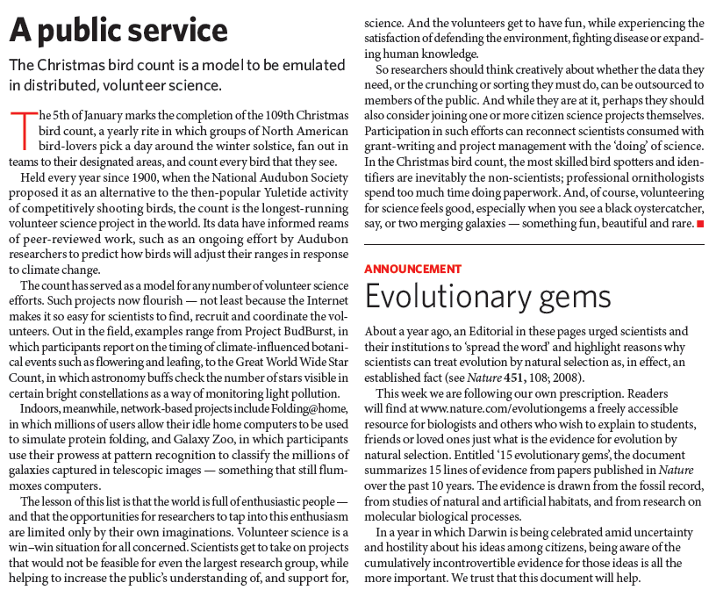

Slide 20
What’s coming…
Many projects gathering large volumes of data which becomes public
SDSS
Transient surveys like ROTSE, PanSTARRs, LSST
NASA instruments all have public archives
National (and international, and simulated) virtual observatories…
This is not only an astronomical phenomenon
Earth observing and geoscience
Planetary Science
Genomics
Social science topics of many kinds…

Slide 21
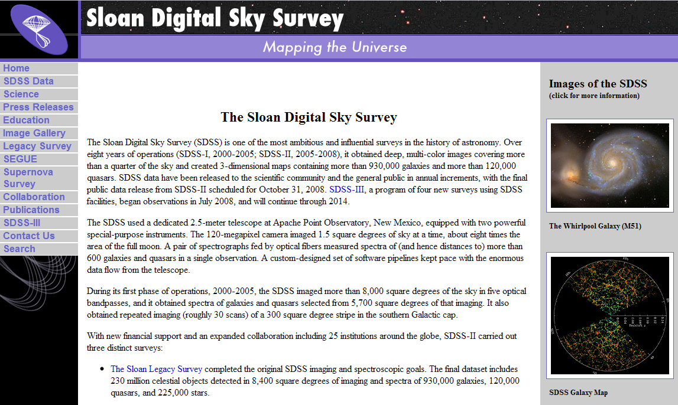

Slide 22
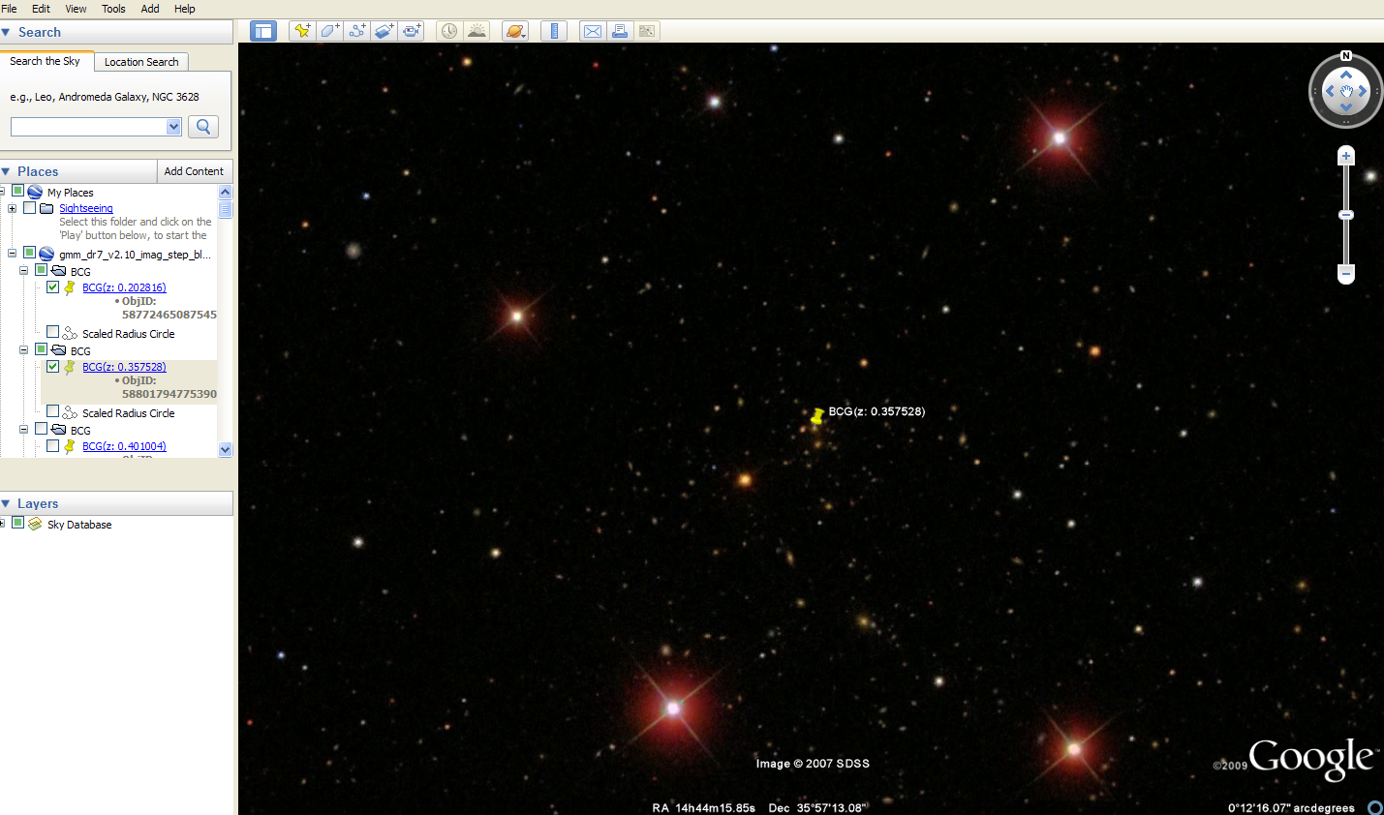
Images can be made accessible in attractive tools like GoogleSky
We use these in our research for data browsing; they’re better than the professional tools

Slide 23
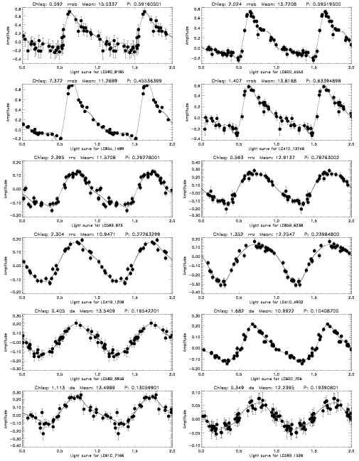
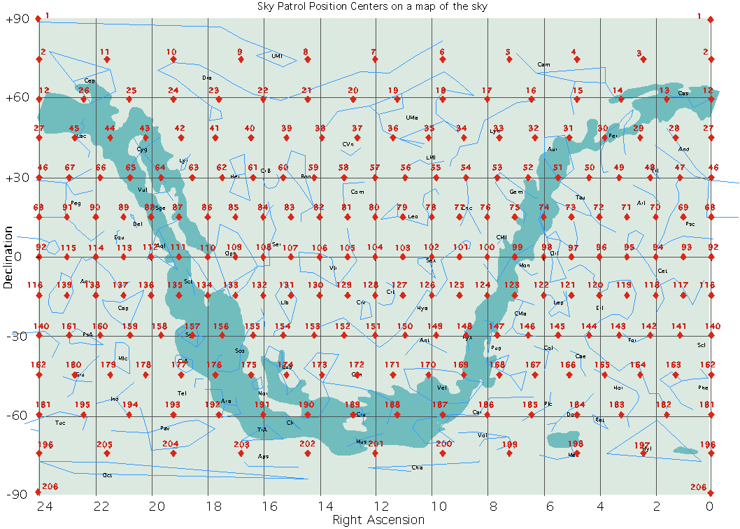
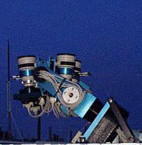
Results from ROTSE all-sky monitoring: the first few thousand variables
Tim McKay: UCSB All-sky monitoring workshop
December 8, 1999
Introduction to the ROTSE project
ROTSE all sky monitoring including results
ROTSE in the future
Notes:
My main goal today is to give everyone over here an update on the ROTSE project. We have been working on ROTSE for a number of years now, and along with some interesting new results, we have reached a turning point in the development of the project. As a result it’s a perfect moment to present a little progress report.
I’ll start by introducing ROTSE, just to set the stage. Then we’ll spend quite a bit of our time talking about how ROTSE studies gamma-ray bursts. We have always intended the ROTSE instrumentation to be used more generally, for study of all kinds of optical transients. Recently we’ve brought those plans to fruition, at least at the level of a demonstration project, so I want to tell you about that too.
Finally, the future for ROTSE is bright, though perhaps a bit daunting, and I will conclude by telling you about that.

Slide 24
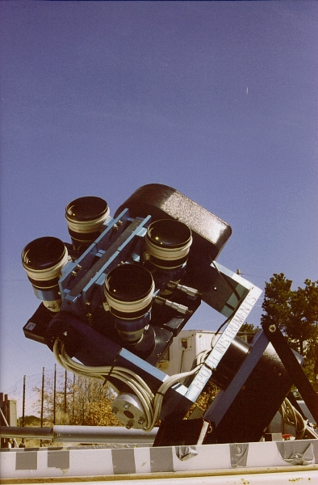
What is ROTSE-I made of?
Optics: four Canon f/1.8 200mm lenses
Cameras: 4 2048² CCDs (14.4” pixels)
16°x16° field of view
Rapid slewing mount
Five Linux control computers
A lot of software (Kehoe + Marshall)

Slide 25
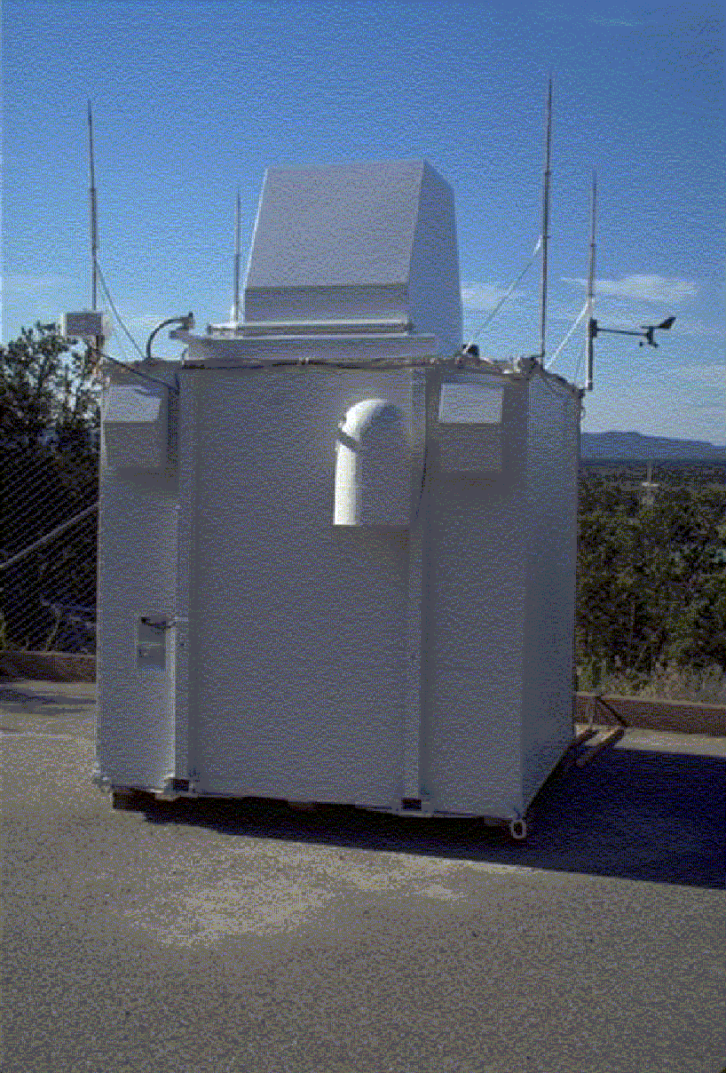
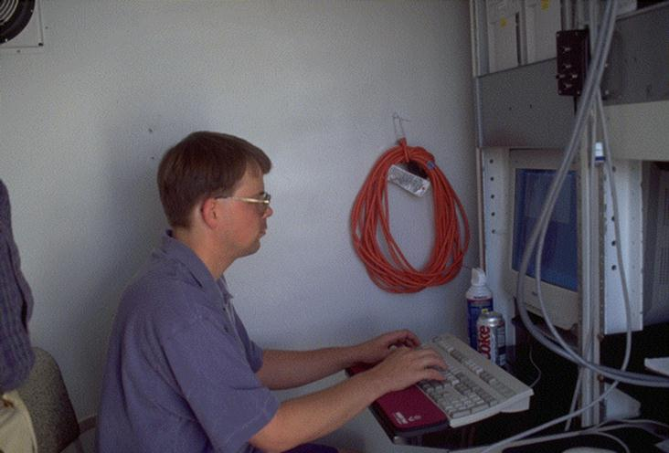
ROTSE-I Operations
The toaster….
Completely automated, unattended, operation (8 Gbytes/night)
Usually, an all-sky patrol instrument
4 patrols (2 pairs) of the entire sky nightly, 80s exposures
Paired images for background rejection
Unfiltered observations
All instantly interruptable by GCN for triggered responses: GRBs
Began operation March 1998
Inside the toaster…..
Notes:
As the Robotic in the title suggests, ROTSE instruments are completely automated. They do everything for themselves, from deciding whether to observe to archiving their data. The ROTSE-I instrument is housed in a military surplus electronics enclosure affectionately known as the toaster. It is equipped with a flip-off roof, weather monitoring, lightning protection, and an internet connection. I would highly recommend such a set-up to anyone considering running a small observatory.
Usually, ROTSE-I is an all-sky patrol instrument, imaging the entire visible sky twice nightly. Each time we observe a location a pair of images is obtained. This is essential for rejection of transient backgrounds.
Once in a while, ROTSE receives a gamma-ray burst trigger, in which case it instantly dumps whatever it’s doing and begins observing the burst location. When we respond to such a trigger we typically obtain a few hundred images of about 1000 square degrees of sky.

Slide 26
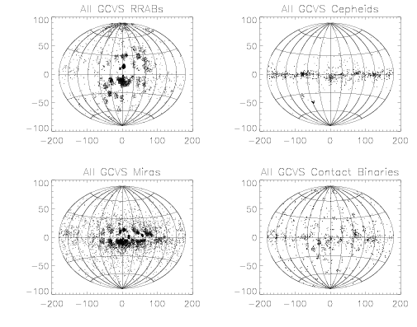
Living up to the ROTSE name: studying other transients
Basic exploration of transient sky is incomplete
Microlensing experiments
Hints of a goldmine
Proof of feasibility
Narrow fields….
ROTSE targets
Pulsating variables
Short transients
Flare stars
Orphan afterglows
Compact objects
Cataclysmic objects
Patchy distributions of GCVS objects
Notes:
So much for GRBs. And while they are both what we got in this for and what pays the bills, there’s a lot more to optical transience in the sky than just GRBs. If the Robotic Optical Transient Search Experiment is to live up to it’s name, we ought to also pay attention to other transients.
At the moment, our global understanding of the transient sky is pretty spotty. This is illustrated in these figures showing the distribution of various GCVS classes on the sky. It’s clear that these samples are all highly incomplete.
Recently, the microlensing experiments have taken steps to reduce this, beating to death a relatively small number of fields. In so doing they have both shown what a gold mine this can be, and demonstrated that it can be done.
What might we study? Well surely the known classes of pulsating variables could use more work. Perhaps more exciting, there are a lot of aperiodic classes which we know exist. For all of these we have only vague ideas of the numbers and properties of their populations. Uncovering these would be a great piece of work, and might turn up something really new.

Slide 27
ROTSE Sky Patrols: keeping a nightly watch
Large field of view allows full sky coverage (4π) in 206 fields
Everything with elevation >20° observed every night
>90 fields and 20,000 square degrees a night
Everything to
-30 regularly
patrolled
Notes:
ROTSE already has a great tool for this, in the form of ROTSE-I sky patrols. We have been obtaining sky patrol data twice a night since March 1998 right up through last night. This is what’s great about robotic instruments. Last night while I was writing this talk ROTSE-I was churning out another 8 gigabytes of patrol data.
During this period we have covered the 160 patrol locations which blanket the sky to -30 dec between 250 and 1200 times. In total we have obtained about 2.6 Terabytes of data; a total of about 430,000 CCD images. Every bit of this data is accessible to us online from the Los Alamos mass storage device.
This is an essential feature of ROTSE’s success in variable analyses. With this we can access any bit of data easily. Without it our lives would be much more difficult. I would say that if you’re interested in doing this you have two choices, obtain a system like this, or analyze all your data in real time. Ideally, you would do both.

Slide 28
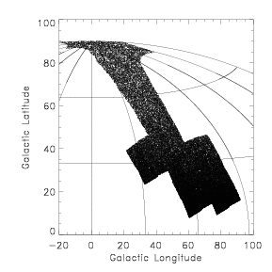
What have we done with it?
Test analysis of 9 (out of 160) fields: 2000 square degrees
5% of the entire sky, 1/17th of available ROTSE-I data
Four months of data (March to June 1999, 40-120 epochs)
RSV1 fields
Note wide
range of
latitudes

Slide 29
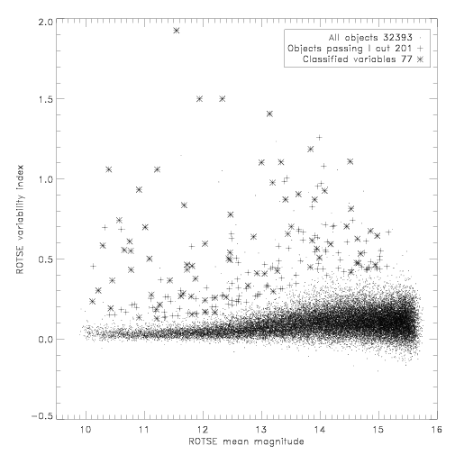
Initial transient analyses
Search for periodic variable
UM undergrads Susan Amrose and Justin Schaefer
Form light curve database for ~10⁶ stars in 2000 square degrees
Use paired observations to eliminate junk, increase sensitivity (Welch-Stetson techniques)
Select variables, automatically phase and classify
Hand scan results
Notes:
Once we calibrate all the data we merge it into a light curve table and search this for variables. All this was done with, and in large part by, two UM undergrads, Susan Amrose and Justin Schaefer.
We have monitored about 917,000 stars for this analysis. We have written code to automatically identify, phase, and classify the stars. For now, we still hand scan all the resulting light curves.

Slide 30
Basic results
1781 classifiable periodic variables found, 90% new
RR Lyrae (ab) 186 Total 60 Known 126 New
RR Lyrae (c) 113 9 104
δ Scuti 91 2 89
Contact Binary 382 14 368
Eclipsing 109 14 95
Mira 146 66 80
Long period var. 534 33 501
Others (Cepheid) 218 2 216
Totals: 1781 (0.2%) 201 1580
26 cross-ids to ROSAT BSC: expect many more
Flash: 104 good matches to internal ROSAT catalogs
269 cross-ids to IRAS PSC: all Miras and LPVs
Already a 30% increase in the total number of variables from m_{v}=10.5 to 12.5
We have another ~60,000 variables sitting on our computers, unloved…
Notes:
At the end of the day we find about 1800 classified variables, of which about 90% are newly discovered. These include substantial numbers of all common types, as shown in this table. I would point out that even variables as easy to identify and as eagerly sought as RR Lyraes are still mostly undiscovered at 12th magnitude.
Interestingly, 26 of our objects are cross-identified with ROSAT bright source catalog sources. Right now Wolfgang Voges is matching our list to the much larger internal ROSAT list, which we expect to turn up about a factor of 5 more matches. It’s likely these objects are RS CVn stars, CVs etc.
Also interesting, 269 of our objects, all Miras and LPVs, are cross-identified with IRAS point sources. This is perfectly consistent with their being pulsating giants.
In sum, this is already a 30% increase in the number of known bright variables, despite the fact that it’s just 5.9% of the ROTSE data.

Slide 31
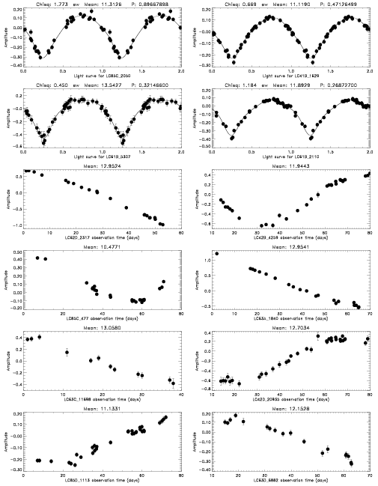
Example Light Curves
RRab
EW
RRc
M
DS
LPV
Notes:
Some example light curves will give you an idea of data quality. Examples are shown here of each of the primary types which we classify. The light curves for RR Lyraes, delta Scuti’s, and contact binaries are phased, those for Miras and LPVs are not.

Slide 32
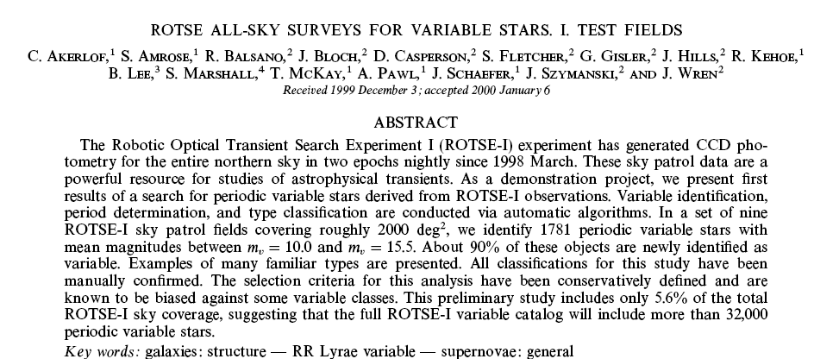
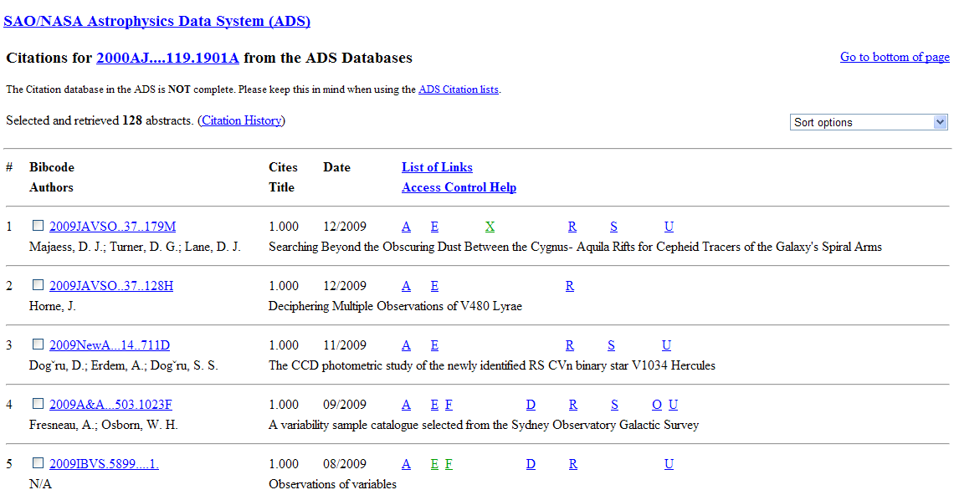

Slide 33
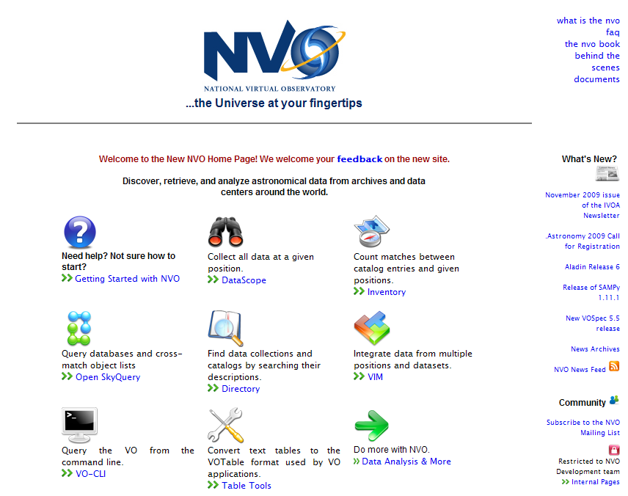

Slide 34
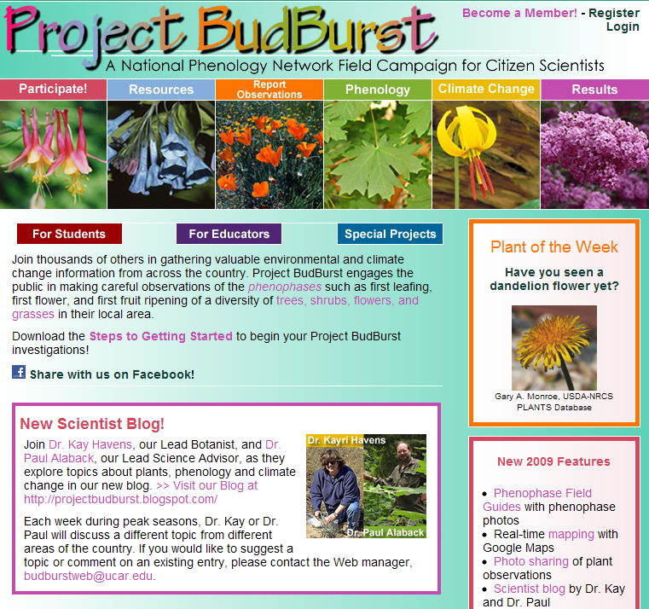

Slide 35
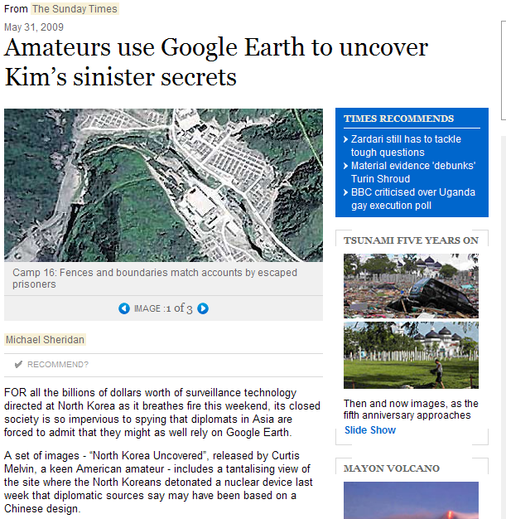

Slide 36
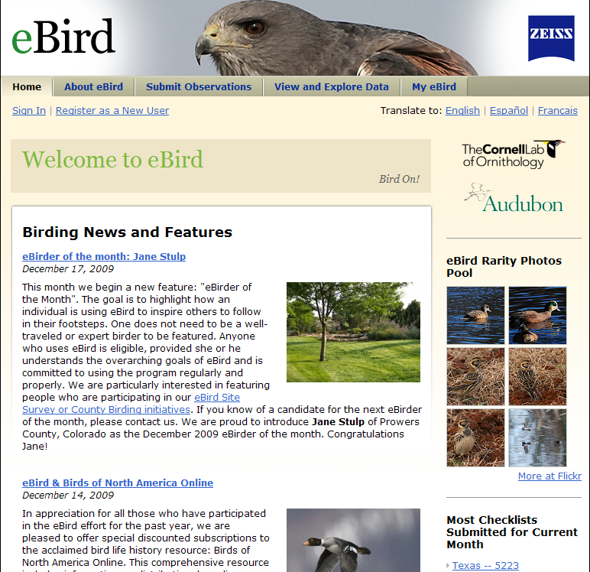

Slide 37
Some conclusions
Amateur and professional comingle in many ways…
Professionals access have resources which used to be their sole province
These are becoming increasingly available to all people
Science is always extremely collaborative and collective
This new data drenched era will enable collective progress which was impossible in the past
Participating in, even just watching this happen, is really fun…

Slide 38
